Slide 1
Closing The Digital Divide in Our Time
5.16.2017

Slide 2
WHO WE ARE
A national nonprofit creating social and economic opportunity by connecting everyone to the Internet
Since 2012, EveryoneOn has connected approximately 400,000 people in the United States and is working to connect one million people by 2020.

Slide 3
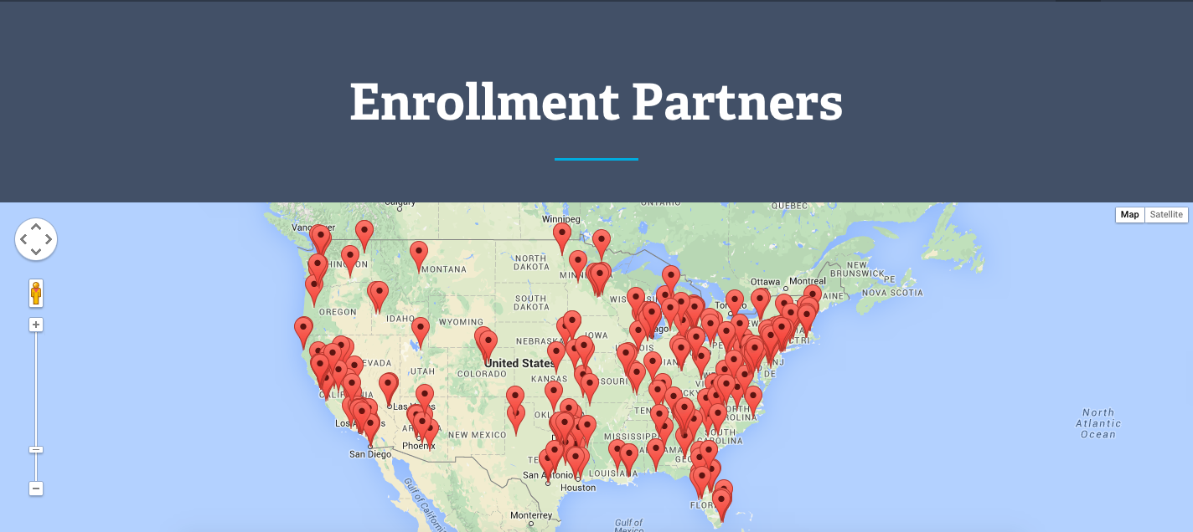
TACKLING THE DIGITAL DIVIDE-ENROLLMENT PARTNERS
TOTAL ENROLLMENT PARTNERS: 687
People served:
1,000-5,000: 87 Enrollment Partners
5,000-10,000: 35
10,000-25,000: 38
25,000-50,000: 20
383 nonprofits, 199 K-12 schools, districts, adult education, 17 libraries

Slide 4
TACKLING THE DIGITAL DIVIDE-NATIONAL INITIATIVES
ConnectED
Goal: connect all K-12 households in participating public housing authorities
Goal: connect 50,000 K-12 students to free Internet service to close the homework gap
Lifeline
Goal: reach and connect “unconnected” households by supporting outreach and adoption efforts
Goal: connect 1 million 9-12 students to free Internet service over five years

Slide 5
TACKLING THE DIGITAL DIVIDE-DEC MOVEMENT
Digital Equity Champions are the individuals, departments, and organizations who currently work with low-income people and families at various eligibility touchpoints
Do you have home Internet service beyond a cell phone?
The Champions
Social Workers Social Service departments
Intake Specialists Public Health departments
Eligibility Verifiers Emergency departments
Case Managers Housing groups
Offer Creation and Negotiation
Full Spectrum Access Platform
On-The Ground
People and Partners
The Touch Points
Applying for public benefits
Benefit recertifications
Housing benefit renewal
Student Financial Aid counseling
Notes:
Become an EveryoneOn Digital Equity Champion. EveryoneOn is building is a nationwide cohort of professional, paraprofessional and counselors who will ask consumers if they have Internet in their home. When a consumer does not have an Internet service, the Champion walks them through the EveryoneOn platform to find the low cost offer of the consumer’s choice. Once Lifeline is rolled out, the greater value will be to help consumers enroll in Lifeline then help them find a low cost Internet offer, discounted device and location for digital literacy training.

Slide 6
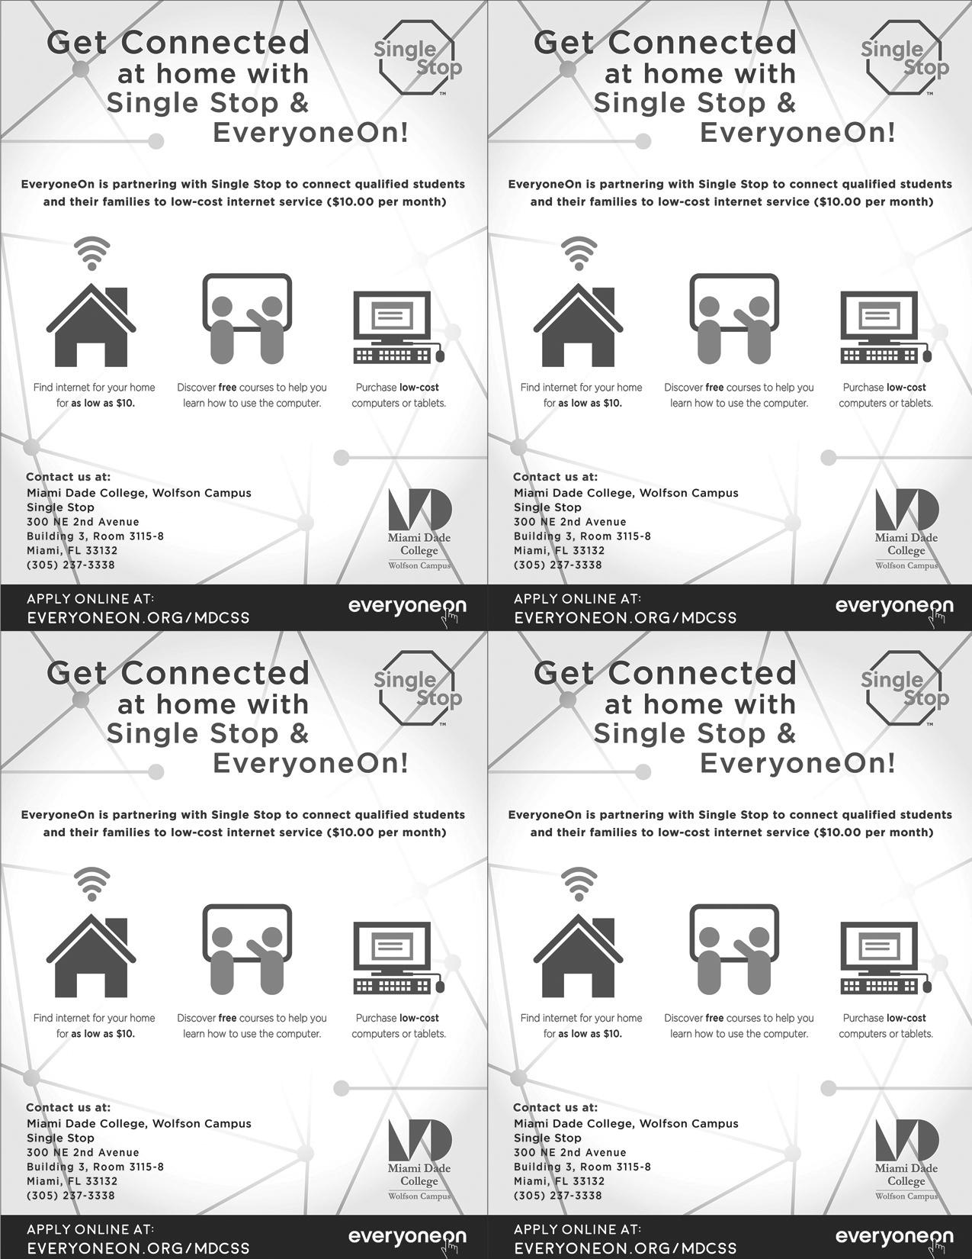
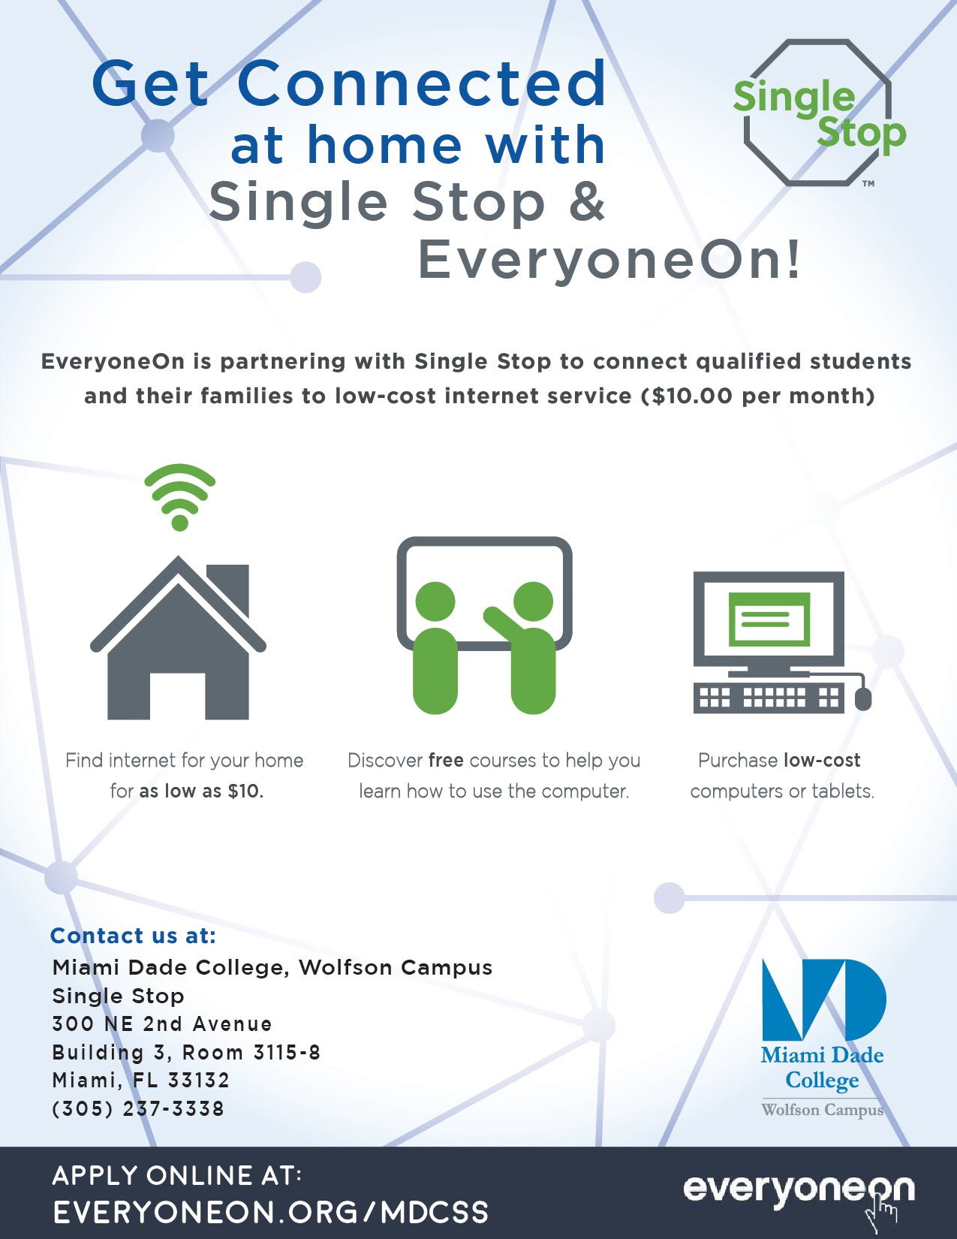
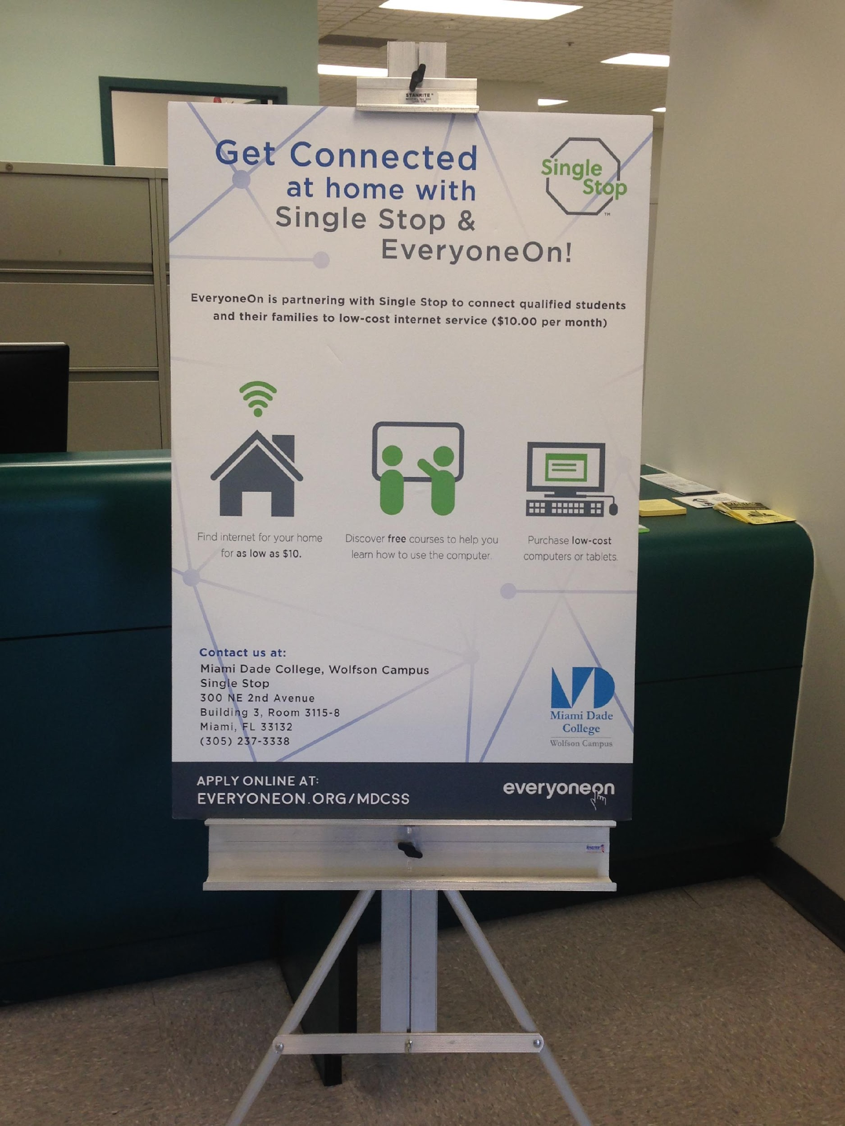
WHERE WE’VE DONE THIS BEFORE
Offer Creation and Negotiation
Full Spectrum Access Platform
On-The Ground
People and Partners
Miami-Dade College a network of 9 campuses serving 94,000+ students

Slide 7
HOW EVERYONEON SUPPORTS DIGITAL EQUITY CHAMPIONS
Sign up now: EveryoneOn.org/digitalequitychampion
EveryoneOn commitments to Digital Equity Champions include:
Collaborating with your organization and/or department to identify how to best include questions about home Internet connectivity during the intake/eligibility process and share EveryoneOn resources with your consumers;
Training on EveryoneOn platform, with landing pages and portal;
Providing your organization and/or department a unique URL and landing page on our website to share low-cost Internet service, affordable computers and devices, and digital literacy resources with your consumers;
Providing real-time analytics on your connectivity efforts (i.e. visits to your unique URL);
Access to webinars, Internet adoption toolkits, and case studies;
Recognition on EveryoneOn media platforms and during conferences.
On-The Ground
People and Partners
Notes:
How to get started: If you, your department or your organization works with low income consumers especially at points of eligibility and benefit enrollment, we invite you to sign up as an EveryoneOn Digital Equity Champion. You can sign up at www.everyoneon.org/digitalequitychampion.
Landing page: www.everyoneon.org/miami everyoneon.org/portal demo/demo

Slide 8
TACKLING THE DIGITAL DIVIDE-OFFER LOCATOR TOOL
Website: www.everyoneon.org
Short Message Service (text): “Connect” to 21-545
Interactive Voice Response
System: (877) 947-4321
ELIGIBILITY QUESTIONS
ZIP CODE
LOW COST INTERNET SERVICE & COMPUTERS
Mobile App:
EveryoneOn
Noun Project Icons: Arthur S., Gregor C., Viktor V., Julynn B., Delwar H., Arejonah

Slide 9
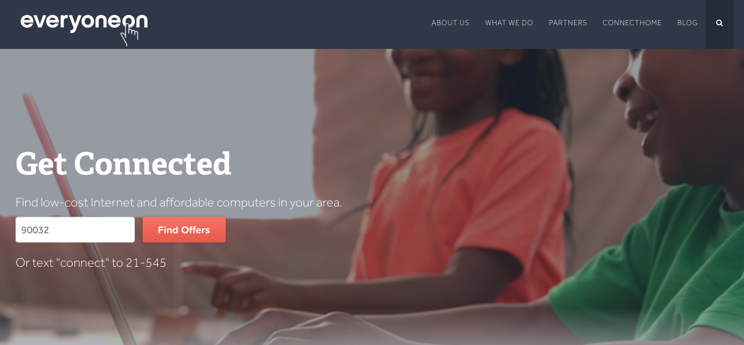
OFFER LOCATOR TOOL
STEP 1: Enter Zip Code

Slide 10
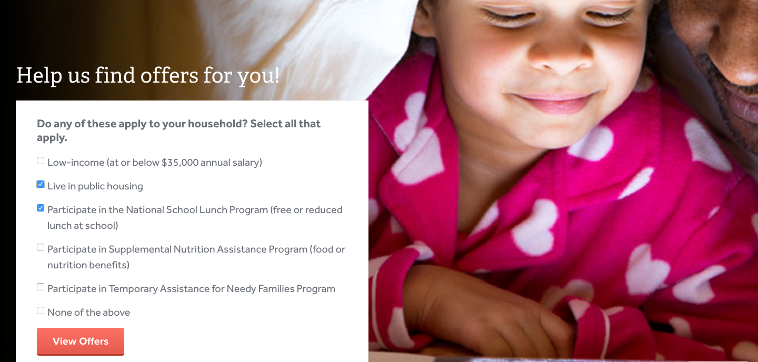
OFFER LOCATOR TOOL
STEP 2: Answer Eligibility Questions

Slide 11
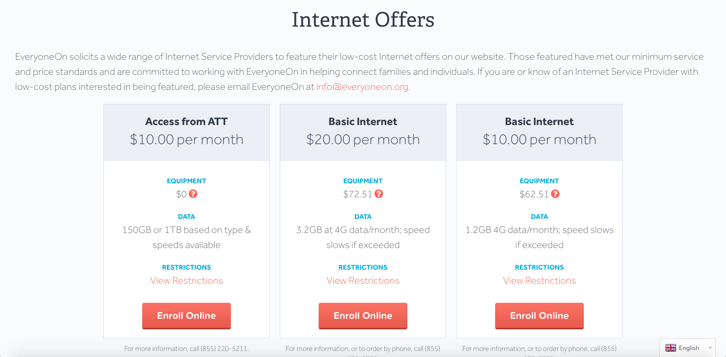
OFFER LOCATOR TOOL
STEP 3: View Offers & Resources

Slide 12
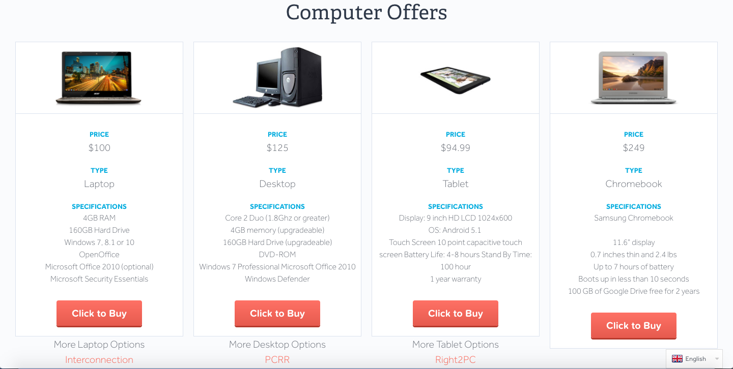
OFFER LOCATOR TOOL
STEP 3: View Offers & Resources

Slide 13
EveryoneOn.org | norma@EveryoneOn.org
786-540-4754

Slide 14
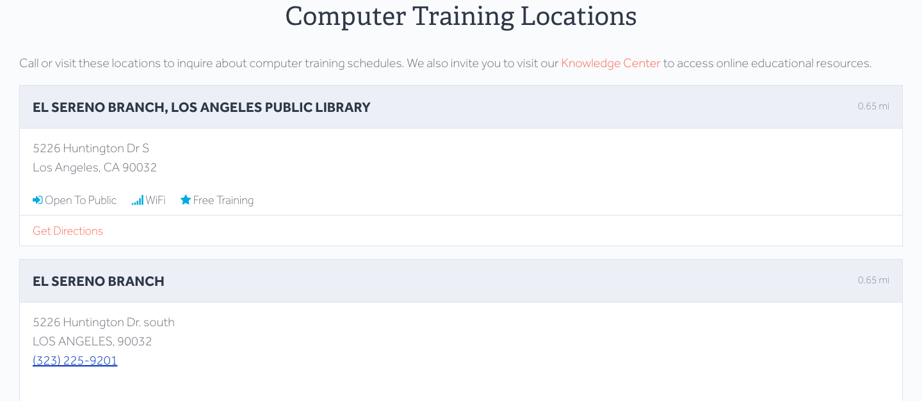
OFFER LOCATOR TOOL
STEP 3: View Offers & Resources-Computer Training

Slide 15
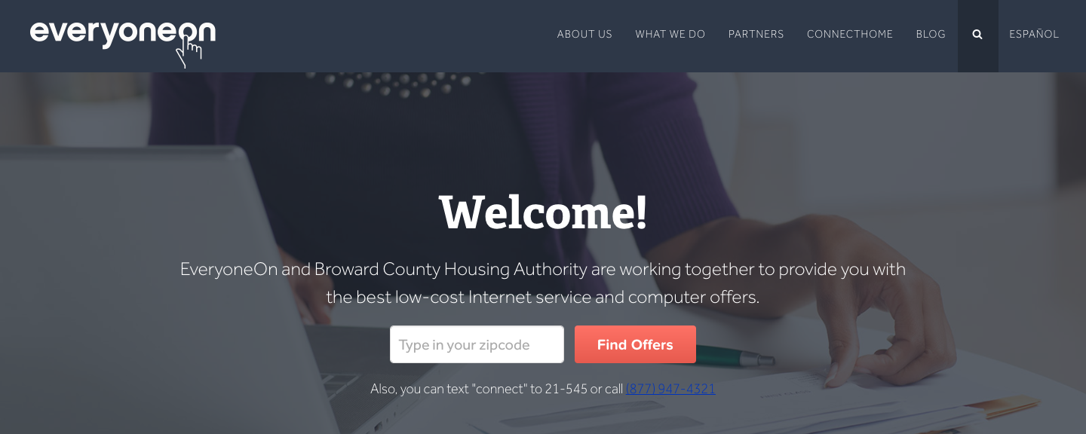
UNIQUE URL
Uniform Resource Locator (URL)—Utilize EveryoneOn.org/bchafl to share the low-cost Internet service and computer offers with your clients

Slide 16
INDIVIDUAL INTERNET SERVICE OFFERS
Internet Service Provider/Network | Program | Price Points | Offer Specifications | Eligibility Requirements
Basic Access (T-Mobile Reseller) | Basic Access | $10.90/month for 1.2GB $42.51 for hotspot, shipping and taxes are applicable | Data: 1.2GB for $10 plan Speeds: 4G; speeds throttle if data is exceeded within month of service and will reset the following month | Live in T-Mobile coverage area
Comcast | Internet Essentials | $9.95/month, taxes may be applicable No modem fee; No installation fee; No cancellation fee; No contract | Speeds: 10 Mbps download/1Mbps upload | Families with K-12 children who participate in the National School Lunch Program, Supplemental Nutrition Assistance Program, Temporary Assistance for Needy Families, or receive Public Housing assistance No outstanding Comcast bills or unreturned equipment Have not subscribed to Comcast High Speed Internet service in the last 90 days
On-The Ground
People and Partners
Notes:
How to get started: If you, your department or your organization works with low income consumers especially at points of eligibility and benefit enrollment, we invite you to sign up as an EveryoneOn Digital Equity Champion. You can sign up at www.everyoneon.org/digitalequitychampion.
Landing page: www.everyoneon.org/miami everyoneon.org/portal demo/demo

Slide 17
INDIVIDUAL INTERNET SERVICE OFFERS
Internet Service Provider/Network | Program | Price Points | Offer Specifications | Eligibility Requirements
AT&T | Access from AT&T | $10/month for 10mbps $10/month for 5mbps $5/month for 3mpbs No modem fee; No installation fee; No cancellation fee; No contract | Speeds will be determined by location: 10 mbps 5 mbps 3 mbps | At least one person in the applying household must be a recipient of SNAP (Supplemental Nutrieint Assistance Program). Unpaid debt to AT&T for certain Internet access services may affect eligibility.
On-The Ground
People and Partners
Notes:
How to get started: If you, your department or your organization works with low income consumers especially at points of eligibility and benefit enrollment, we invite you to sign up as an EveryoneOn Digital Equity Champion. You can sign up at www.everyoneon.org/digitalequitychampion.
Landing page: www.everyoneon.org/miami everyoneon.org/portal demo/demo

Slide 18
BULK INTERNET SERVICE OFFERS
Internet Service Provider/Network | Program | Price Points | Offer Specifications | Eligibility Requirements
Sprint | PCsforPeople (in partnership with Mobile Beacon) | $10.00-$13.33 $74.95 for Netgear Fuse hotspot, free shipping (one-time cost) Plans: 3 Months-$40 6 Months-$75 12 Months-$120 | Data: Unlimited Speeds: 4G; no throttle | Live in Sprint coverage area Participate in one of the following: SNAP, NSLP, TANF, GA, Medicaid, Medical, Public Housing, Section 8, SSD, SSI Or be 200% poverty level: must show prior year’s state, federal, or tribal tax return; social security statement, VA statement of benefits, retirement/pension statement of benefits, unemployment/workers compensation statement of benefits
On-The Ground
People and Partners
Notes:
How to get started: If you, your department or your organization works with low income consumers especially at points of eligibility and benefit enrollment, we invite you to sign up as an EveryoneOn Digital Equity Champion. You can sign up at www.everyoneon.org/digitalequitychampion.
Landing page: www.everyoneon.org/miami everyoneon.org/portal demo/demo

Slide 19
BULK INTERNET SERVICE OFFERS
Internet Service Provider/Network | Program | Price Points | Offer Specifications | Eligibility Requirements
T-Mobile |  | $240 for 2 years of service (upfront) Tablet is free | Data: 2GB/month Speeds: 4G; speeds throttle if data is exceeded | Minimum order of 10 tablets Live in T-Mobile coverage area
On-The Ground
People and Partners
Notes:
How to get started: If you, your department or your organization works with low income consumers especially at points of eligibility and benefit enrollment, we invite you to sign up as an EveryoneOn Digital Equity Champion. You can sign up at www.everyoneon.org/digitalequitychampion.
Landing page: www.everyoneon.org/miami everyoneon.org/portal demo/demo

Slide 20
DEVICE OFFERS
 | DEVICE PROVIDER |  | PRICE
DESKTOPS
1 |  | Right2PC | $162
2 |  | PCRR-STANDARD | $210
3 |  | PCRR | $162
4 |  | Interconnection | $125
LAPTOPS
1 |  | Right2PC | $202
2 |  | PCRR-STANDARD | $279
3 |  | PCRR | $202
4 |  | Interconnection | $175
5 |  | PCs for People | $160
TABLETS
1 |  | Right2PC | $143
2 |  | T3 Partners | $95
CHROMEBOOK
1 |  | Chromebook | $249
Notes:
How to get started: If you, your department or your organization works with low income consumers especially at points of eligibility and benefit enrollment, we invite you to sign up as an EveryoneOn Digital Equity Champion. You can sign up at www.everyoneon.org/digitalequitychampion.
Landing page: www.everyoneon.org/miami everyoneon.org/portal demo/demo

Slide 21
INTEGRATING INTERNET QUESTION
When to ask clients? Strategic Touch Points:
Application process
Recertification
1:1 eligibility sessions
FSS meetings
What to Ask?
Do you have Internet have home beyond a cell phone?
Are you interested in low-cost Internet service and/or computers?
On-The Ground
People and Partners
Notes:
How to get started: If you, your department or your organization works with low income consumers especially at points of eligibility and benefit enrollment, we invite you to sign up as an EveryoneOn Digital Equity Champion. You can sign up at www.everyoneon.org/digitalequitychampion.
Landing page: www.everyoneon.org/miami everyoneon.org/portal demo/demo

Slide 22
ACTIVITY
Decision Tree
Points of Relevancy
Why Cellphones Are Not Enough
On-The Ground
People and Partners
Notes:
How to get started: If you, your department or your organization works with low income consumers especially at points of eligibility and benefit enrollment, we invite you to sign up as an EveryoneOn Digital Equity Champion. You can sign up at www.everyoneon.org/digitalequitychampion.
Landing page: www.everyoneon.org/miami everyoneon.org/portal demo/demo

Slide 23
DEC DATA PORTAL
DEC Data Portal
www.everyoneon.org/decs
Username: URL identifier
(i.e. bchafl)
Password: password
URL Activity Tracked
# of visits
# of exists to Internet service offers
# of exits to computer offers

Slide 24
DEC DATA PORTAL

Slide 25
DEC RESOURCES

