Slide 1
Inclusive Smart Cities
Denise Linn, Program Analyst for the Smart Chicago Collaborative
Net Inclusion Summit
May, 17, 2017
@DKLinn | @SmartChicago

Slide 2
@DKLinn | @SmartChicago

Slide 3
The Smart Chicago Collaborative is a civic organization devoted to improving lives in Chicago through technology.
@DKLinn | @SmartChicago

Slide 4
About Smart Chicago Collaborative
We were founded in 2011 by the City of Chicago, The Chicago Community Trust & the MacArthur Foundation.
We care about access to the Internet, digital skills, and data.
@DKLinn | @SmartChicago

Slide 5
Notes:
CUTGroup

Slide 7
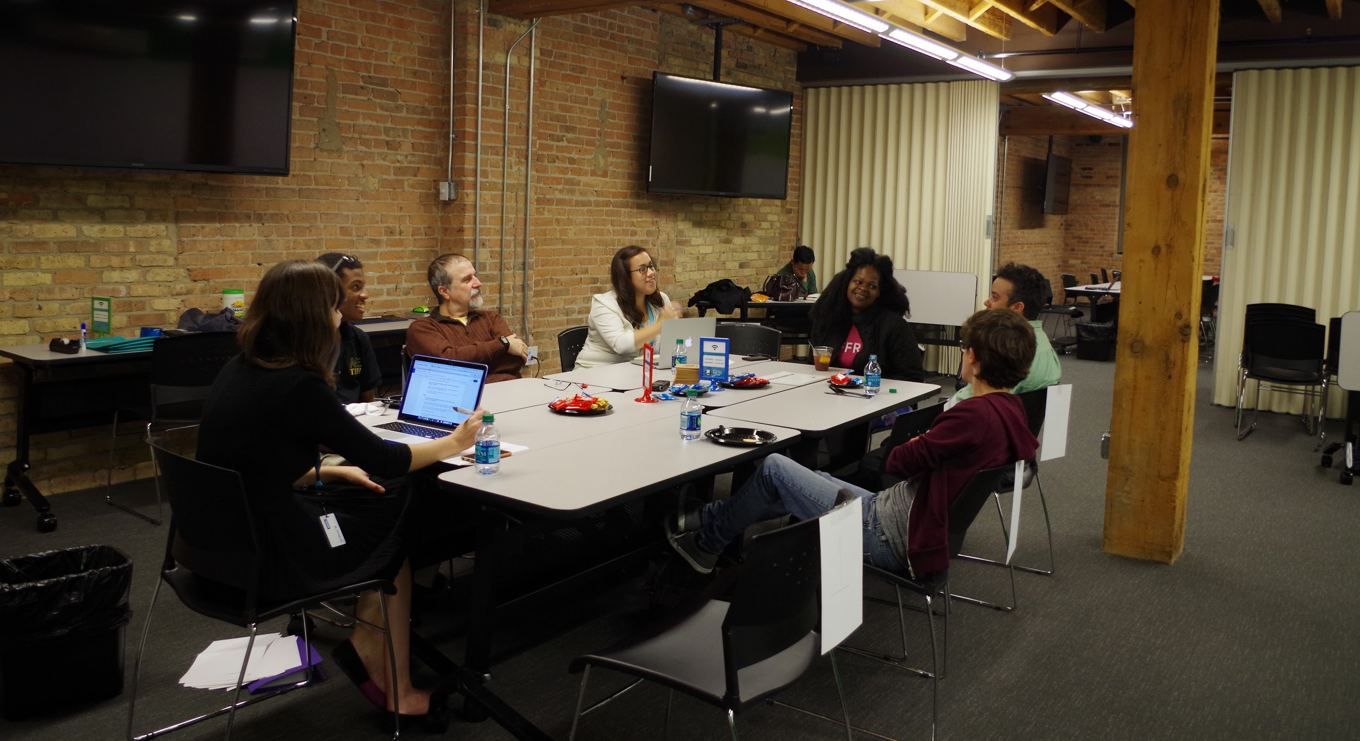

Slide 8
Notes:
Community Tech Forums

Slide 9
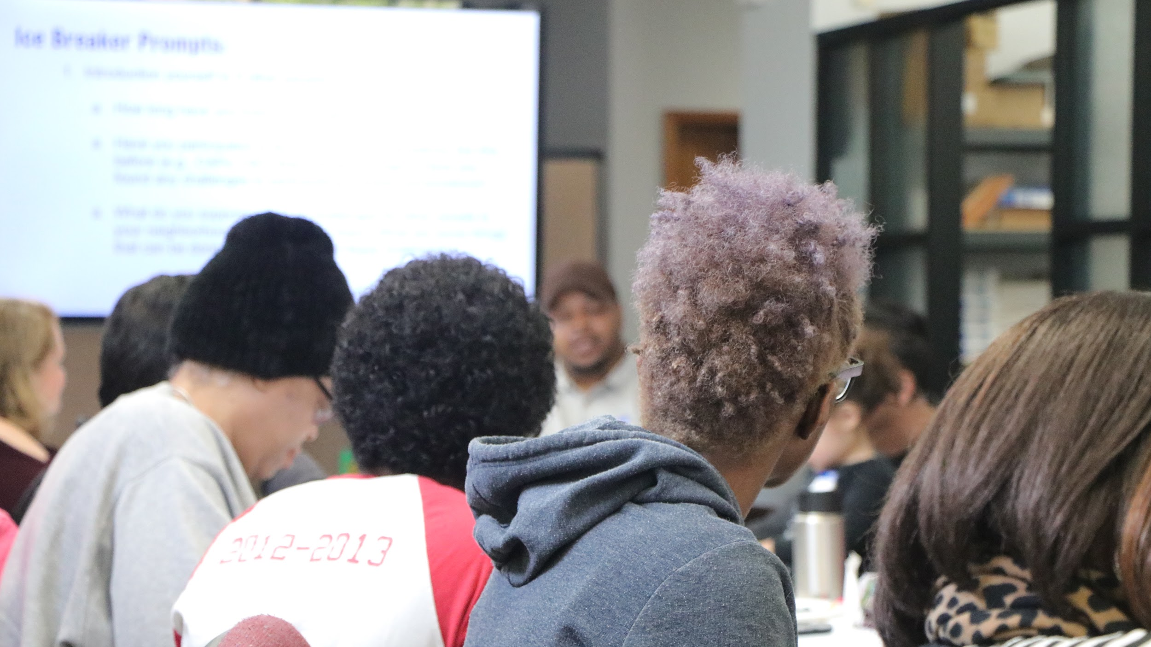
Notes:
Skills - ex: Youth-Led Tech

Slide 10
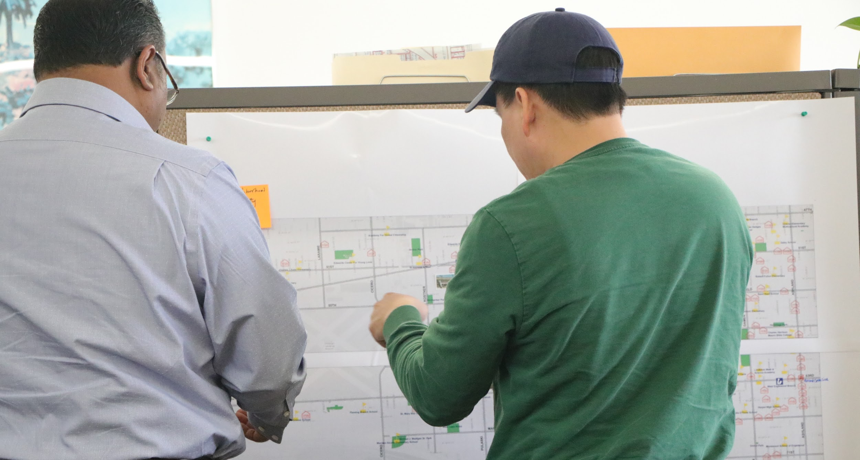
Notes:
Skills - ex: Youth-Led Tech

Slide 11
Array of Things Civic Engagement
At Smart Chicago, we seek to help build a smart city that works for everyone — a city where the technical infrastructure, data, tech tools, and tech training that are shaped by residents and serve them.
@DKLinn | @SmartChicago
Notes:
Case in Smart City Inclusive Building

Slide 12
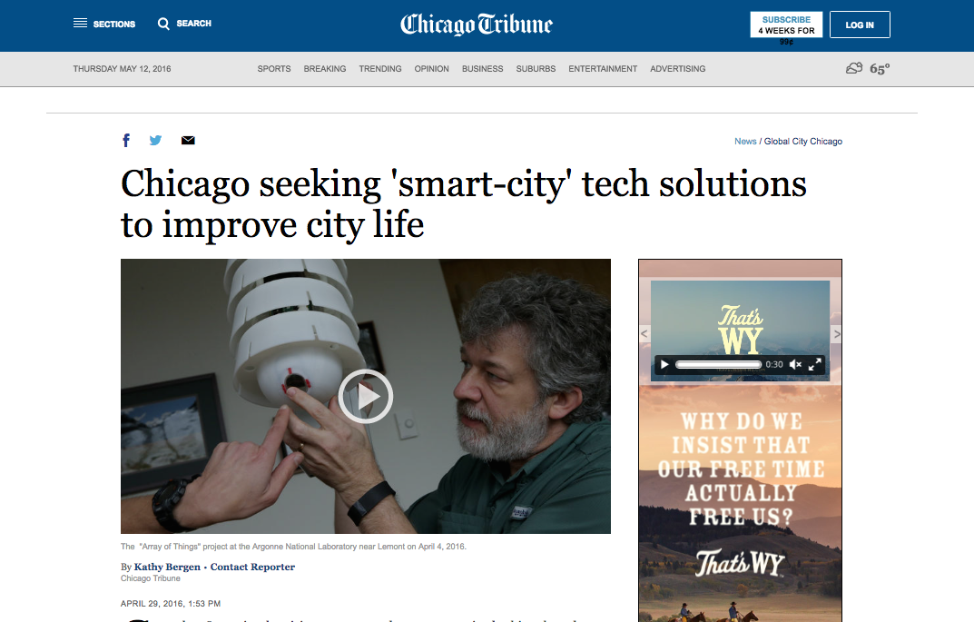

Slide 13
About the Array of Things Civic Engagement Project
Smart Chicago led the civic engagement process to educate residents and gather input from communities on new sensor technology in Chicago.
We hosted public meetings and collected feedback on the Array of Things Governance & Privacy Policies.
We documented everything and published an Engagement Report summarizing resident feedback.
@DKLinn | @SmartChicago
Notes:
Array of Things is a network of interactive, modular sensor boxes that will be installed around Chicago to collect real-time data on factors that impact livability in Chicago (ex: climate, air quality, noise). The project’s operators are the University of Chicago and Argonne National Laboratory.
The City is also a major partner in this work. The City of Chicago is releasing Privacy & Governance Policies for the Array of Things project. A 2 week public comment period will follow.

Slide 14
Goals for this Work
To educate Chicago about the Array of Things project, process, the potential of the research, and the sensors’ capacities
To gather public input on the Draft Array of Things Privacy Policy
To gather community input on the livability factors most of interest to them and most pressing to their neighborhoods
To help further the national conversation about privacy, the Internet of Things and civic engagement in smart city building
@DKLinn | @SmartChicago

Slide 15
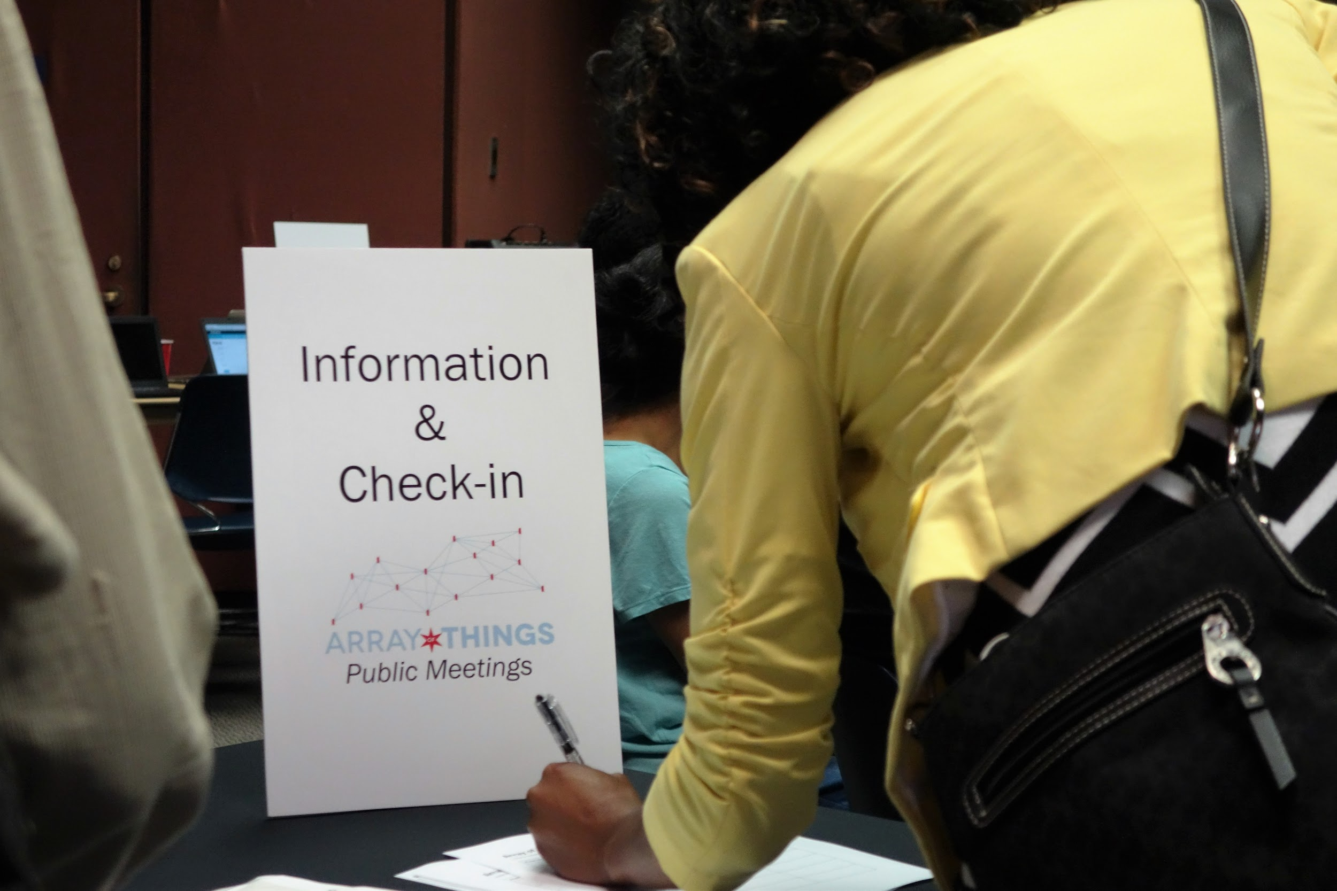

Slide 16
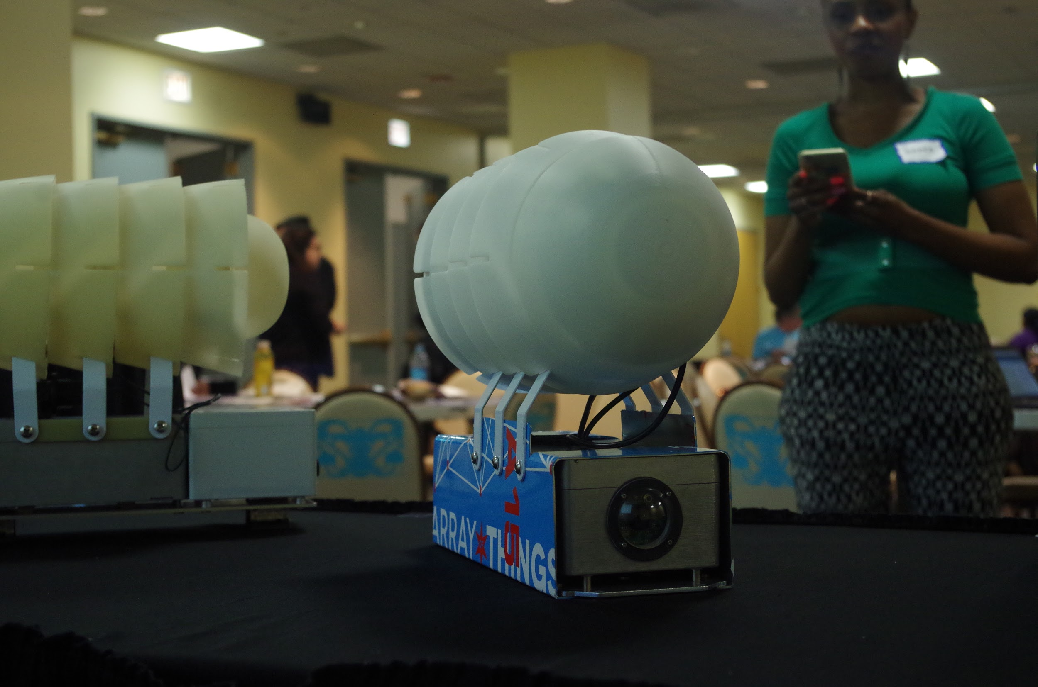

Slide 17
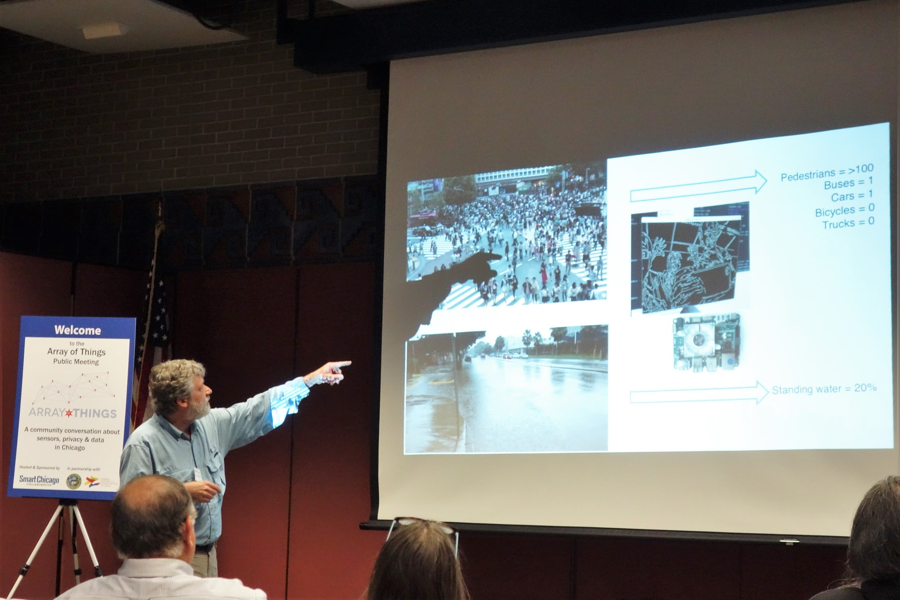

Slide 18
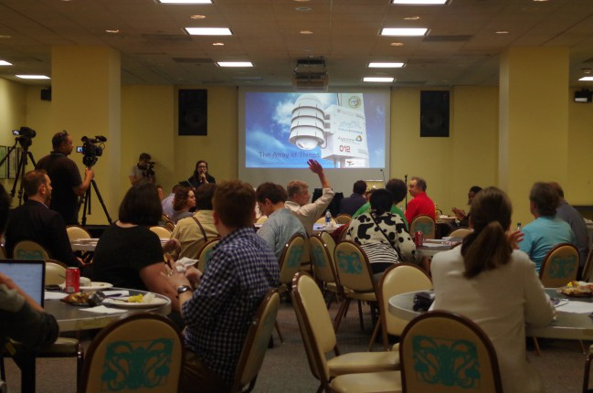

Slide 19
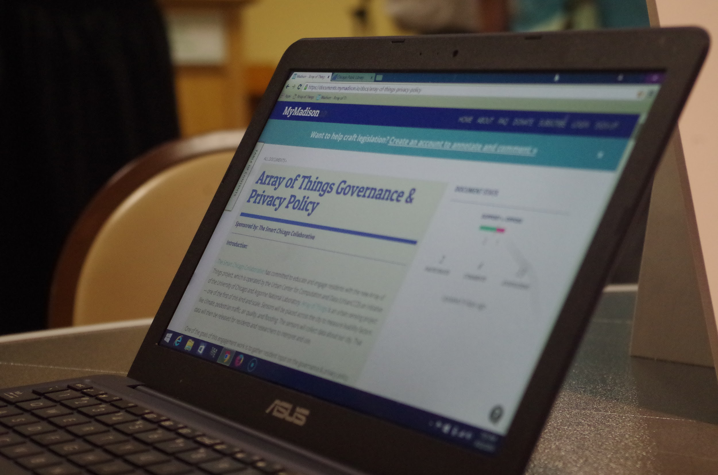

Slide 20
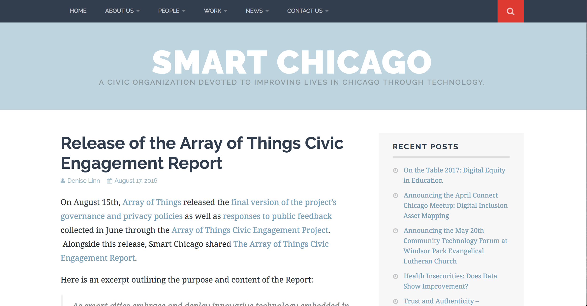
Notes:
Link: https://www.slideshare.net/smartchicago/array-of-things-engagement-report-august-2016

Slide 21
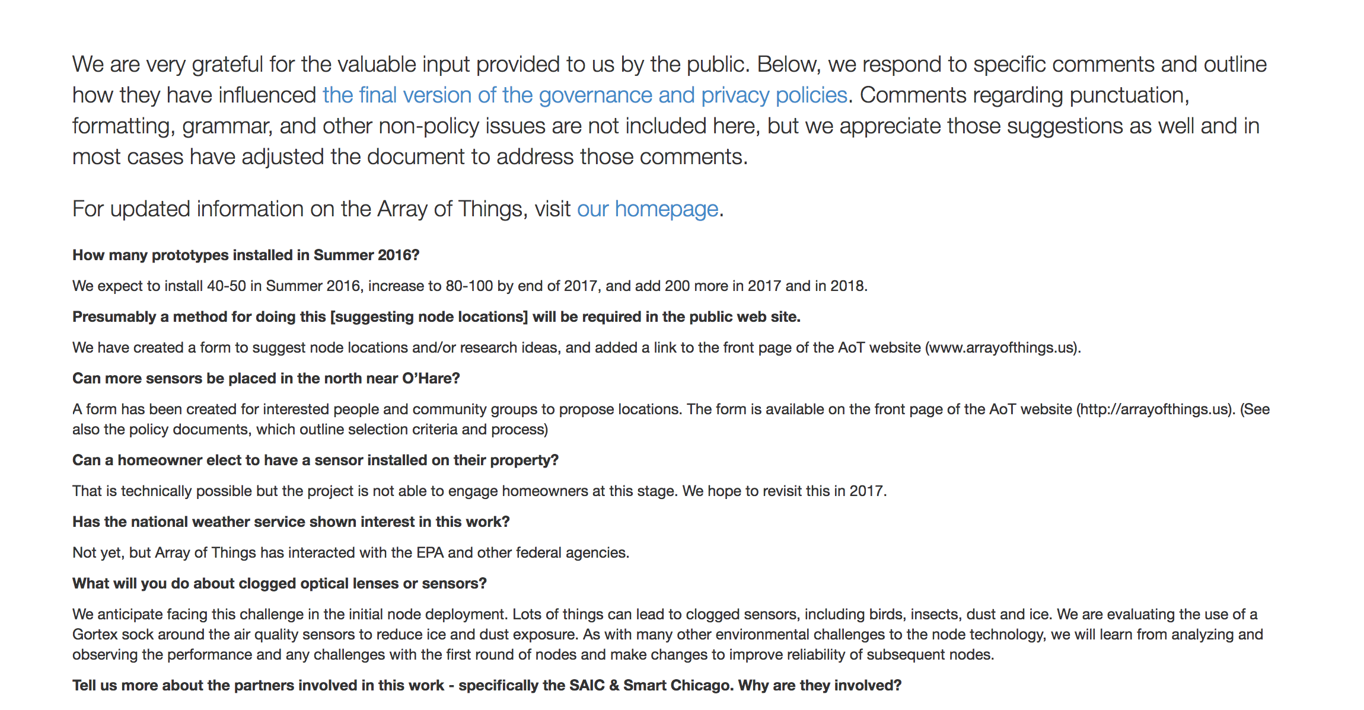

Slide 22
Lessons in Engagement with Smart City Projects
Engaging & informing at the same time is a challenge.
There is a trade-off between technical transparency & accessibility.
Communicate the value of technology in use cases. Also be clear about what the technology doesn’t do in addition to what it does do.
Be tool agnostic about collecting public feedback.
Meet people where they are.
@DKLinn | @SmartChicago

Slide 23
Questions?
dlinn@cct.org
@DKLinn | @SmartChicago

