Slide 1
Evaluating Digital Literacy Programs with Ethnography
Net Inclusion 2017
Shauna Edson
Digital Inclusion Fellow, Salt Lake City Public Library
sedson@slcpl.org

Slide 2





Slide 3
The Salt Lake City Public Library is a dynamic civic resource that promotes free and open access to information, materials and services to all members of the community to advance knowledge, foster creativity, encourage the exchange of ideas, build community and enhance the quality of life.

Slide 4

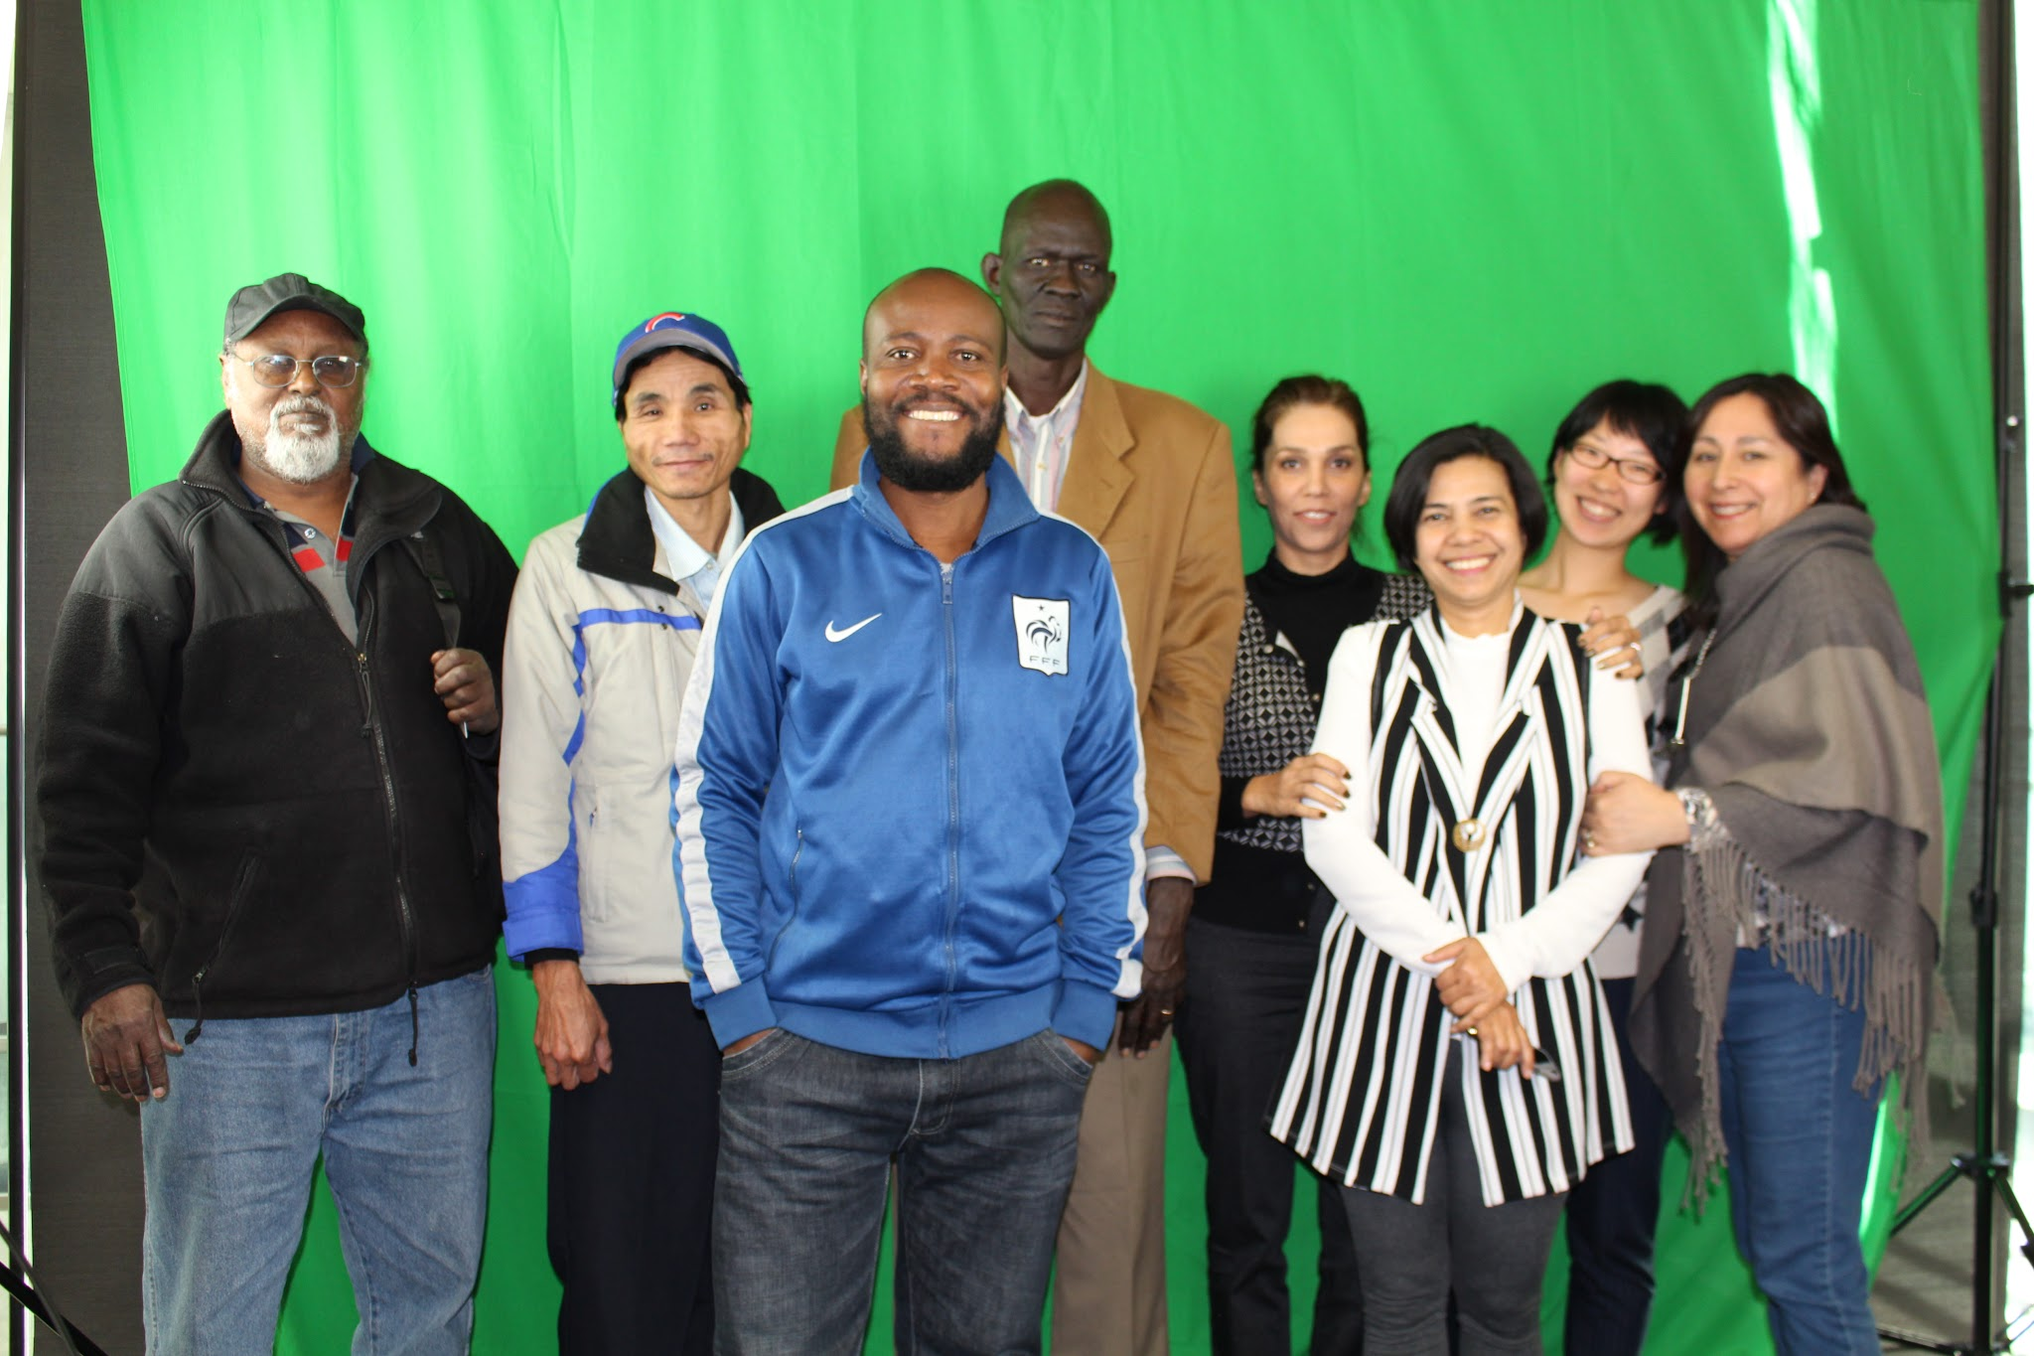
The Tech League’s goal is to understand who in our community lacks Internet access and to bring the Library’s resources and tools to those individuals to foster independence, connection, and success in our digital world.

Slide 5
Tech League Volunteers
Library volunteers are ambassadors who project a positive image of the Library and its services. Volunteers are accepting of all people and have a passion to assist diverse populations to ensure they have a positive Library experience. They are team players who have the ability to think quickly and make quality decisions. They are organized and pay attention to detail.
Provide one-on-one tech assistance to Library patrons.

Slide 6
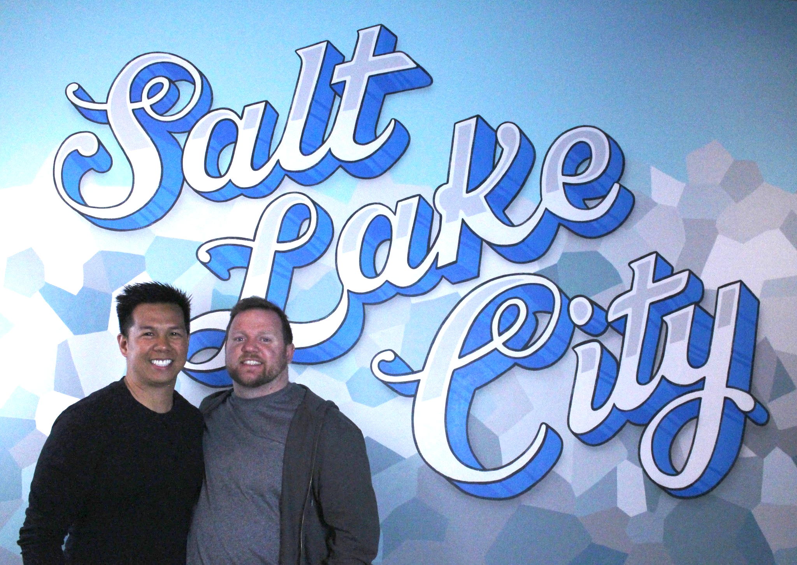
25
Active Volunteers
835
Volunteer hours
860
Patrons Helped

Slide 7
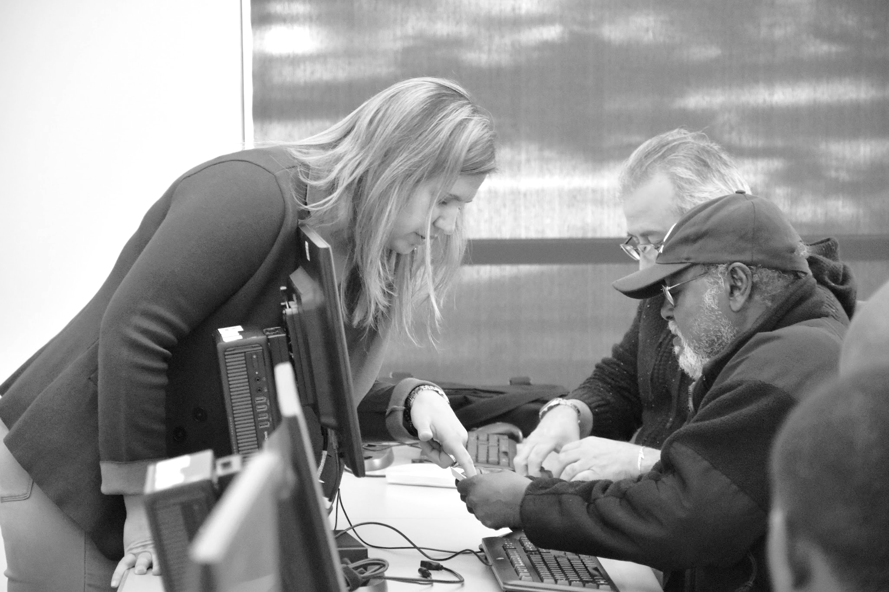
Tech League Volunteers help patrons with:
Job searches
Resumes
Email
Facebook/social media
Printing/Scanning
Tinkercad
Adobe Suite
Word/Excel
File Management
Library database

Slide 8
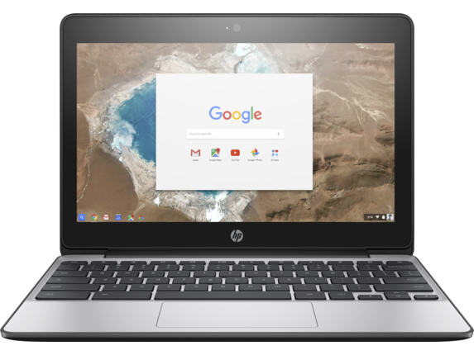
Laptop Discovery Kit
Access to Technology and WiFi:
Launch date March 17th, 2017
Five Kits at four branches
Kits include Chromebook, Hotspot, bag, mouse, power cord, user agreement
Google Fiber sponsored another 20 kits.

Slide 9

Laptop Discovery Kit
How many times has it been checked out?
37 Patrons checked out the kit, and there are 37 on hold
Are patrons using the chromebook, Hotspot, or both?
55% both, 33% chromebook, 11% Hotspot
What are patrons using the kit for?
Entertainment, work, learning a new skill, communication, job seeking, paying bills, other.

Slide 10
Community Partners
Ballpark Apartments
Department of Workforce Services
Glendale - Mountain View Community Learning Center
Horizonte Instruction and Training Center
Liberty Senior Center
Lowell Bennion Community Service Center
Refugee & Immigrant Center - Asian Association of Utah
Salt Lake County Library
Utah Pride Center
Utah State Library
VOA Youth Resource Center for Homeless and At-Risk Teens

Slide 11
Community Partners
Open Computer Lab with one-on-one tech assistance available:
28 students
784 Student Hours in the lab
254 hours with one-on-one tech assistance
  Online high school completion
  Setting up email
  Navigating/registering websites
  Social Media
  Basic computer skills
  Google Drive
  File management
Five students graduating from high school on June 1, 2017.

Slide 12
Ethnography
Ethnography is a qualitative design in which the researcher describes and interprets the shared and learned patterns of values, behaviors, beliefs, and language of a culture-sharing group.
~ John W. Creswell

Slide 13
Ethnography
Shauna: And, is the Internet important to you?
Sofia: It is very important because I live with my younger girl and she is a high school student. And so she really need it. And I started using it a lot too [laughs].
Shauna: And, what do you use it for?
Sofia: For the school. And I’m not going to lie, I saw my TV shows sometimes [laughs]…
Shauna: Your TV shows? Great. [laughing]. Yes, I like Netflix. Umm, how long have you been using the Internet?
Sofia: Umm, many years because first was my oldest one and then now my younger one. So I have like 10 years I guess. They are like five years apart. Laura used it in middle school and then go to high school and then university. And the younger one start middle school and then high school.

Slide 14
Ethnography
Shauna: So when your oldest daughter started middle school, that’s when you started using the Internet?
Sofia: Mhmm.
Shauna: And, are you comfortable using the Internet?
Sofia: Yeah. Now I am feeling better because I think I learned more to use it. Because before it was like complicated and I wouldn’t use it at all. Because I can just go to see my Facebook [laughing] so…But now I can use it more. I can find a recipe for cook. I can find the things for my school I think that I need to, and my TV shows. Yeah.

Slide 15
Ethnography: Preliminary Findings
The majority of the students coming to the class are seeking high school completion, and participate in the program to gain access to technology, tutoring, child care, and work with other students on their coursework.
Most students felt comfortable interacting with technology, and felt like they could use technology to help them meet their educational goals.
Students use computers and the Internet for research, socializing, and using the Google Drive to email and create documents and slides for assignments.
The students that have Internet at home stated that education for themselves or their children was one of the most important uses of the Internet.
As students interacted with the Internet and computers for educational purposes, they also developed a familiarity with technology that transferred to other areas.

Slide 16
“We must negotiate how to appreciate and celebrate differences while thinking collectively, openly, and practically about how information communication technologies connect and affect our everyday lives.”
~ Joy Pierce, Digital Fusion: A Society Beyond Blind Inclusion

