Slide 1

What Are We Accomplishing? Approaches to Digital Inclusion Program Evaluation
Samantha Schartman-Cycyk
Research Director, Connect Your Community Institute
Notes:
Greetings everyone and thank you for attending our session – I am Samantha Schartman-Cycyk and I am the Research Director for the the Connect Your Community Institute, and a program evaluation consultant for nonprofits.
So I spend most of my time thinking about creative and holistic ways of measuring program impact and teasing up ways for my clients to leverage the impact of their programs for growth and sustainability.

Slide 2
Mobile Beacon: Research Schedule
Data mining/clean-up
  Validate your data and streamline collection!
Direct client (nonprofit) partner survey
  Learn about the relationships your partners may have with your constituents.
End-user survey
  Quantify your impact.
Customer service/feedback testimonial interviews
  Qualify your impact
Social Network Mapping/Anthropological investigation
  Better understand the community your serve
Notes:
And recently, I had the privilege to work with Mobile Beacon……
For those of you who may not be familiar, Mobile Beacon is a Educational Broadband Service Provider who provides reduced-cost, unlimited 4G mobile broadband service to the nonprofit community.
This uniquely holistic and comprehensive research schedule was completed over a 6-month period. But in the interest of time, today I am going to talk about just one leg of this project – the end-user survey.

Slide 3
Bridging the Gap:
What Affordable, Uncapped Internet Means for Digital Inclusion
A Mobile Beacon Digital Inclusion Survey
Notes:
And that end-user survey report is entitled: Bridging the Gap: What Affordable, Uncapped Internet Means for Digital Inclusion.
For those of you who might be interested, the research brief is available now – see me for a copy, or is also available at the link on the NDIA website under this session description. And the full report is slated to be released next week via the NDIA listserve – if you’re not on that list and want the report sent to you – let me know after the session.

Slide 4
Methodology
  415 completed survey responses, statistically significant within a 5% margin of error for entire subscriber population.
  Past digital inclusion program trainees were put through specialized workforce training to conduct the survey.
Notes:
For this effort, we called a random sample of 2,930 subscribers of the Bridging the Gap program. And from that completed 415 surveys in full.
This was more than enough to provide statistical significance for the population served within a 5% margin of error – which is a standard margin similar to those you find in pew and census data.

Slide 5
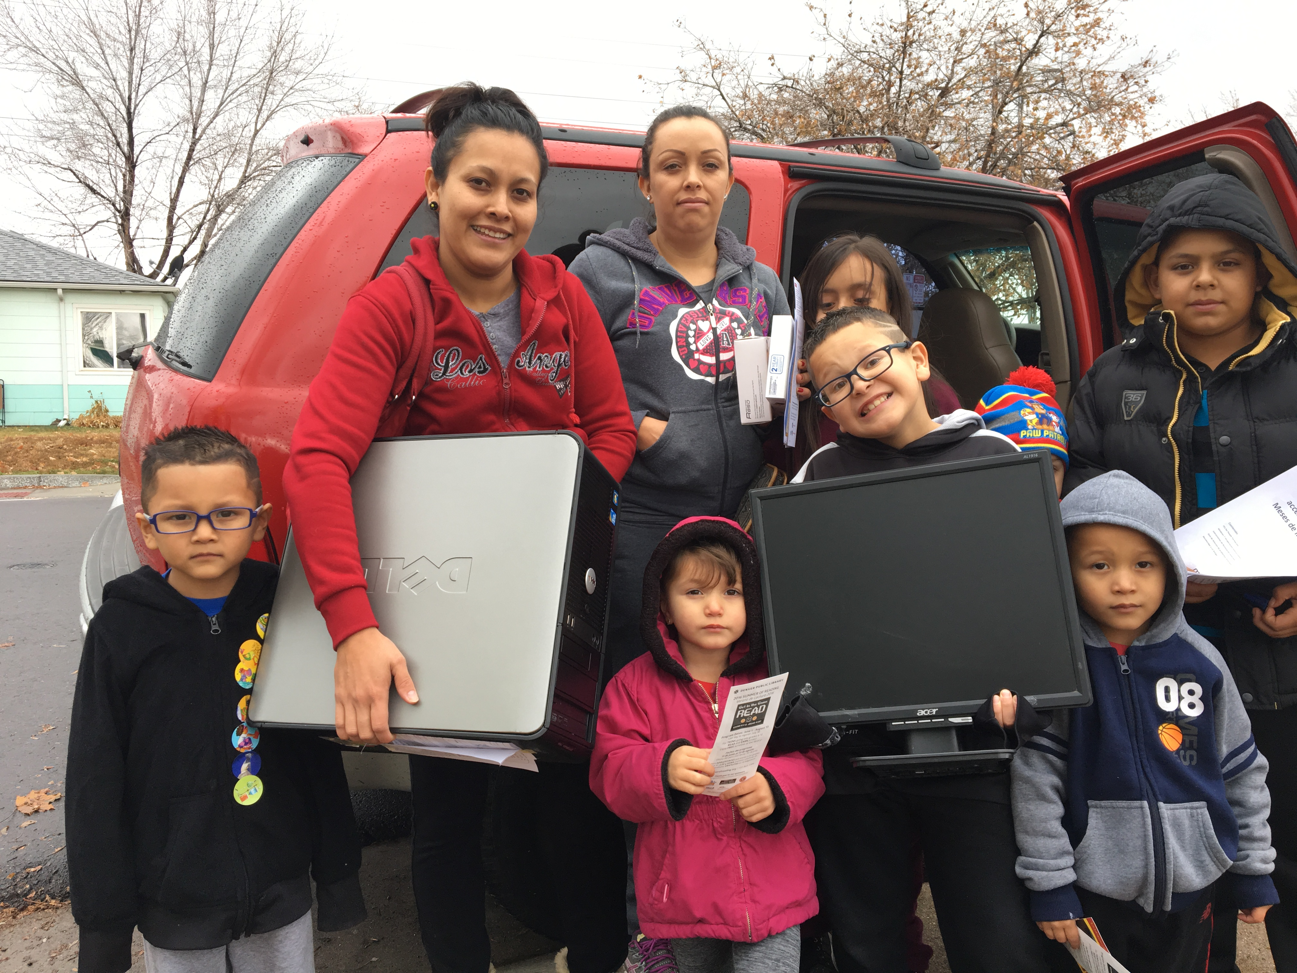
Population
  Must make less than 200% of federal poverty OR be on Governmental assistance.
  Participants’ average reported income is only $23,228 per year.
  56% of all respondents live alone or with only one other person.
  41% of all 2-person households are single-parent homes.
  Bridging the Gap subscribers are 16% more likely to be parents than the average American (Jonathan Vespa, 2013).
  Respondents own an average of 3.5 internet-capable devices each.
Notes:
So here is a little about the population we interviewed….
Subscribers make an average of just over $23,000 year
Over half of subscribers live in a one or two person home…..and over 40% of those 2-person homes are single –parents!

Slide 6
Internet Use
  The average user consumes 41GB of data each month.
  82% of respondents report to spend several hours each day using their Mobile Beacon internet service
  In 60% of households containing a school-aged child, the child (or children) are equal or primary users of the internet.
  40% of respondents report taking their service outside the home while the remaining 60% prefer using their “beacon” as a fixed and reliable home broadband service.
Notes:
Now Mobile Beacon as a service provider can look at the amount of data consumed, but what they can’t see…..at least currently….is the frequency in which the service is being used or for what activity. So we needed to ask these questions in order to pair it with consumption data to get a better view of the value that is being created….
What we found is the average user consumes about 41GB of data each month
Most customers use the service as a fixed broadband service in the home
Children are often primary users of the service
And people report to use the service fairly extensively.

Slide 7
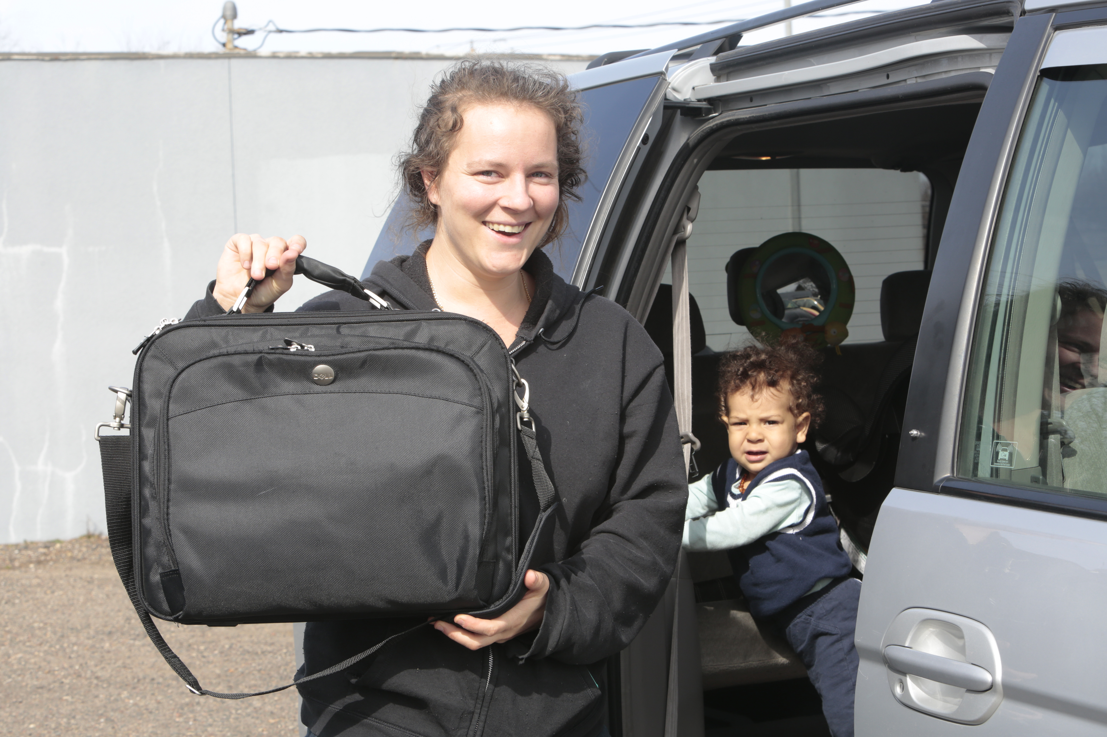
Educational Use
  88% of students used their Mobile Beacon internet service to engage in school-related activities.
  94% of all parents reported that having Mobile Beacon internet service helped them to better support their child/children in school.
  32% of respondents report that someone in their household is currently taking adult/continuing education classes or attending college
Notes:
So we looked at several online activity centers – from workforce and health-related related uses, to entertainment, financial management, and even e-commerce….and if you are interested in those findings – I encourage you to check out the full report.
In doing so, – Mobile Beacon is very education-focused – and we found that the educational uses were very high – so this was a win….
In fact, of all these areas of online activity the two that stood out from a frequency and data use perspective – are education, and work-related activity – meaning job-search, online job skills training, and even after hours work activity……

Slide 8
Data Usage Trends
  Those using their internet service in support of their educational goals used an average of 25GB MORE than the average user.
  The data used by those reporting online activities such as searching for jobs, engaging in online job-skills training, and doing work-related activities off-hours is 14 GB greater than those reporting to not engage in such activities.
Notes:
So here are 2 findings that we found to be quite impressive.
Those using their service for education-related activities online use a whopping 25GB MORE than the average user….Now remember from the previous slide – the average user consumes about 41GB each month. This means that those trying to further their education, are using in access of 66GB every month on average.
Those trying to get ahead in the workforce? They used 14GB more than the average user!
These are staggering numbers!
And they also go to show – when people raise the question of “mobile” in a digital inclusion strategy – unless that mobile service is being provided by Mobile Beacon or Mobile Citizen, a user would need in most cases a extremely expensive plan in order to be able to support the data needed to pursue these life goals!
With most retail mobile plans starting at 3-5GB/month….for $30+ per month….on top of regular service fees, for someone needing 60+ GB/month – they would immediately need an unlimited plan – which often cost in access of $100 per month! This is not a strategy for closing the digital divide.

Slide 9
Data Caps
  94% of all respondents without an unlimited data plan report having a plan that included less than 10 GB per month.
    2/3rds of these had 5 GB or less and 30% had 2 GB or less.
  22% of respondents reported that there were online activities they were unable to engage in prior to signing up for Mobile Beacon’s unlimited internet service due to a lack of data.
    60% of respondents report difficulty using their previously capped service for online classes or homework.
Notes:
In fact, we asked our respondents what type of internet they had before they signed up with Mobile Beacon, and of those reporting to have relied on a mobile data plan….if they didn’t have an unlimited plan,
94% of all respondents without an unlimited data plan report having a plan that included less than 10 GB per month.
22% of respondents reported that there were online activities they were unable to engage in prior to signing up for Mobile Beacon’s unlimited internet service due to a lack of data.
60% of respondents reported difficulty using their previously capped service for online classes or homework.
Think about it for a moment - a single 90 min. HD video streamed over Netflix can use 5 GB of data alone (Willcox, 2016)

Slide 10
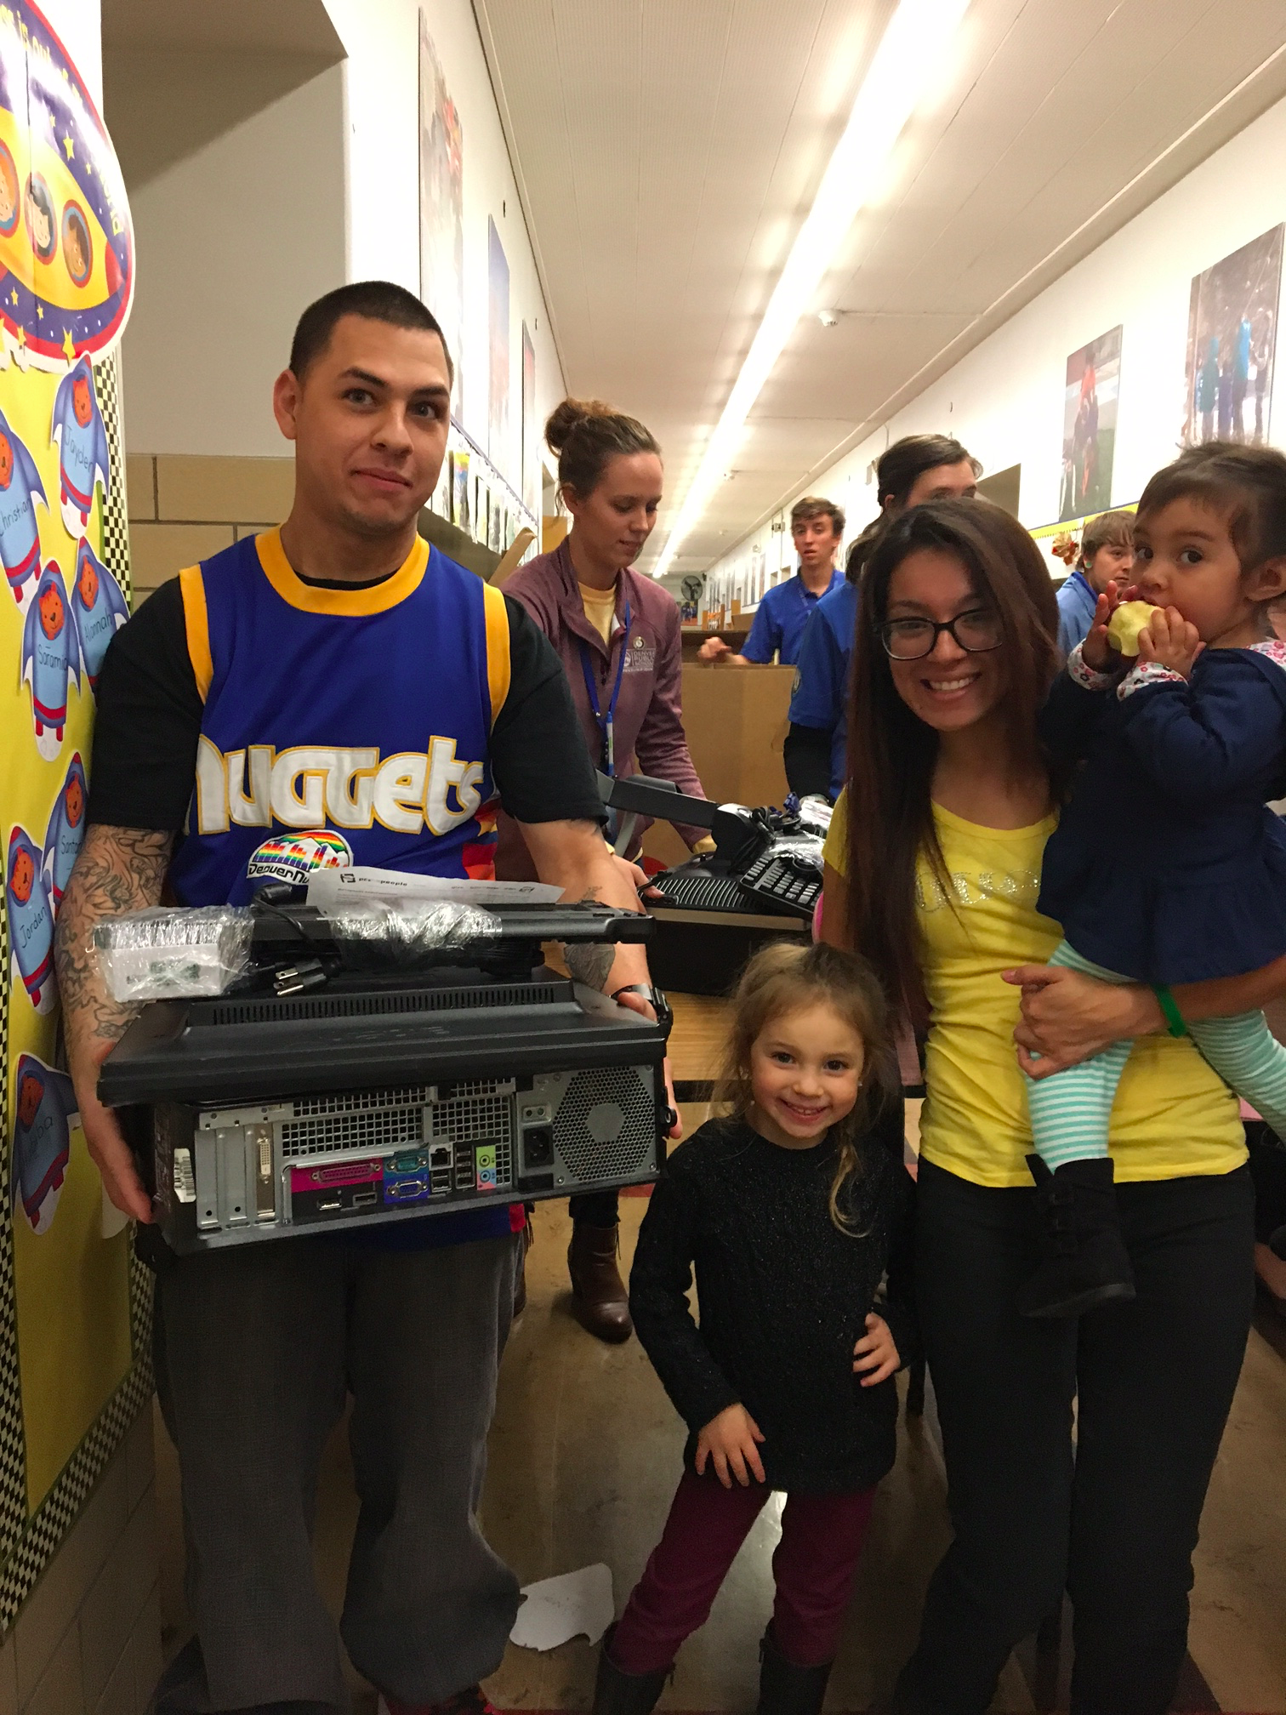
Cost Savings
  Average cost of commercial mobile internet service:
    $12 per GB/month (Louis, 2013)
  Average home wireline (DSL, Cable) plan
    >$50 per month (Sherman, 2015).
  This strains low-income families living within a tight budget, often pricing them out of the market.
  77% of respondents report to have saved money by signing up for Mobile Beacon service
Notes:
So with that in mind….did people save money by switching to Mobile Beacon service – you betcha!

Slide 11
Reported Cost Savings by Survey Respondents After Signing up For Mobile Beacon Service
Notes:
And the cost savings for some were significant.

Slide 12
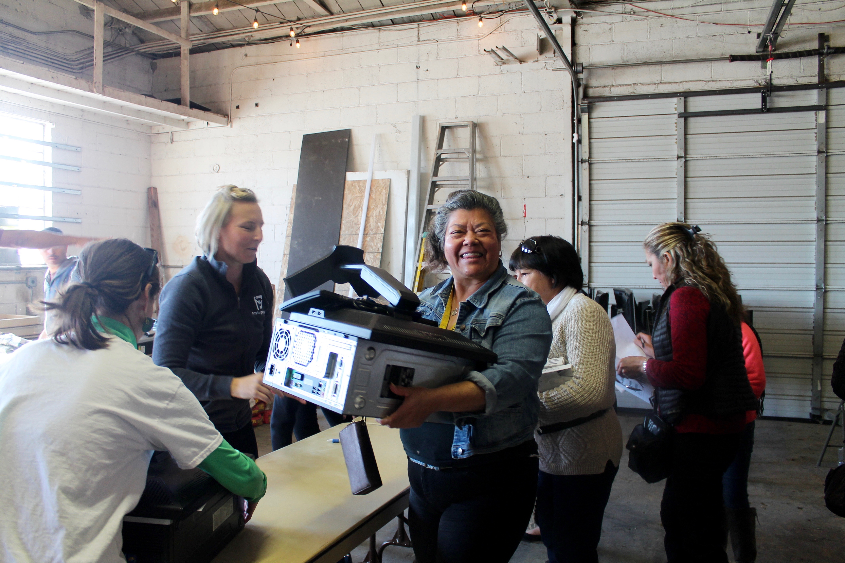
More on Cost Savings
  Survey respondents reporting to have previously had an internet account through a traditional telecommunications company collectively saved a median of $2,560 each month.
  This adds up to $30,720 every year that they are a Mobile Beacon customer.
  That’s an average savings of $445 per year for each account holder.
Notes:
That is just the respondent pool….if we apply those trends to the whole of the Bridging the Gap subscriber population -
The collective median cost-savings for all Bridging the Gap subscribers would be $110,646 each month, or $1,327,752 every year!

Slide 13
Marketing
  92% of all respondents used a community resource to find and enroll in Bridging the Gap program:
  71% of respondents reported to have been told about the program by a friend or family member.
  An additional 21% reported to have learned of the program from a community nonprofit or service agency.
  Only 8% said they found the program independently through online search or another means.
  This underscores a major trend in the field of digital literacy and technology equity; the power and strength of community networks.
Notes:
So what we found is that this program really enjoyed a high level of “viral marketing” meaning – that most – an overwhelming majority - did not learn about Bridging the Gap through traditional marketing – like print or TV ads – they learned about it from other subscribers – or friends or family of subscribers…a much smaller – but not insignificant number learned about the program through a relationship with a community service agency.
Just 8% found the program fully organically…..by chance.

Slide 14
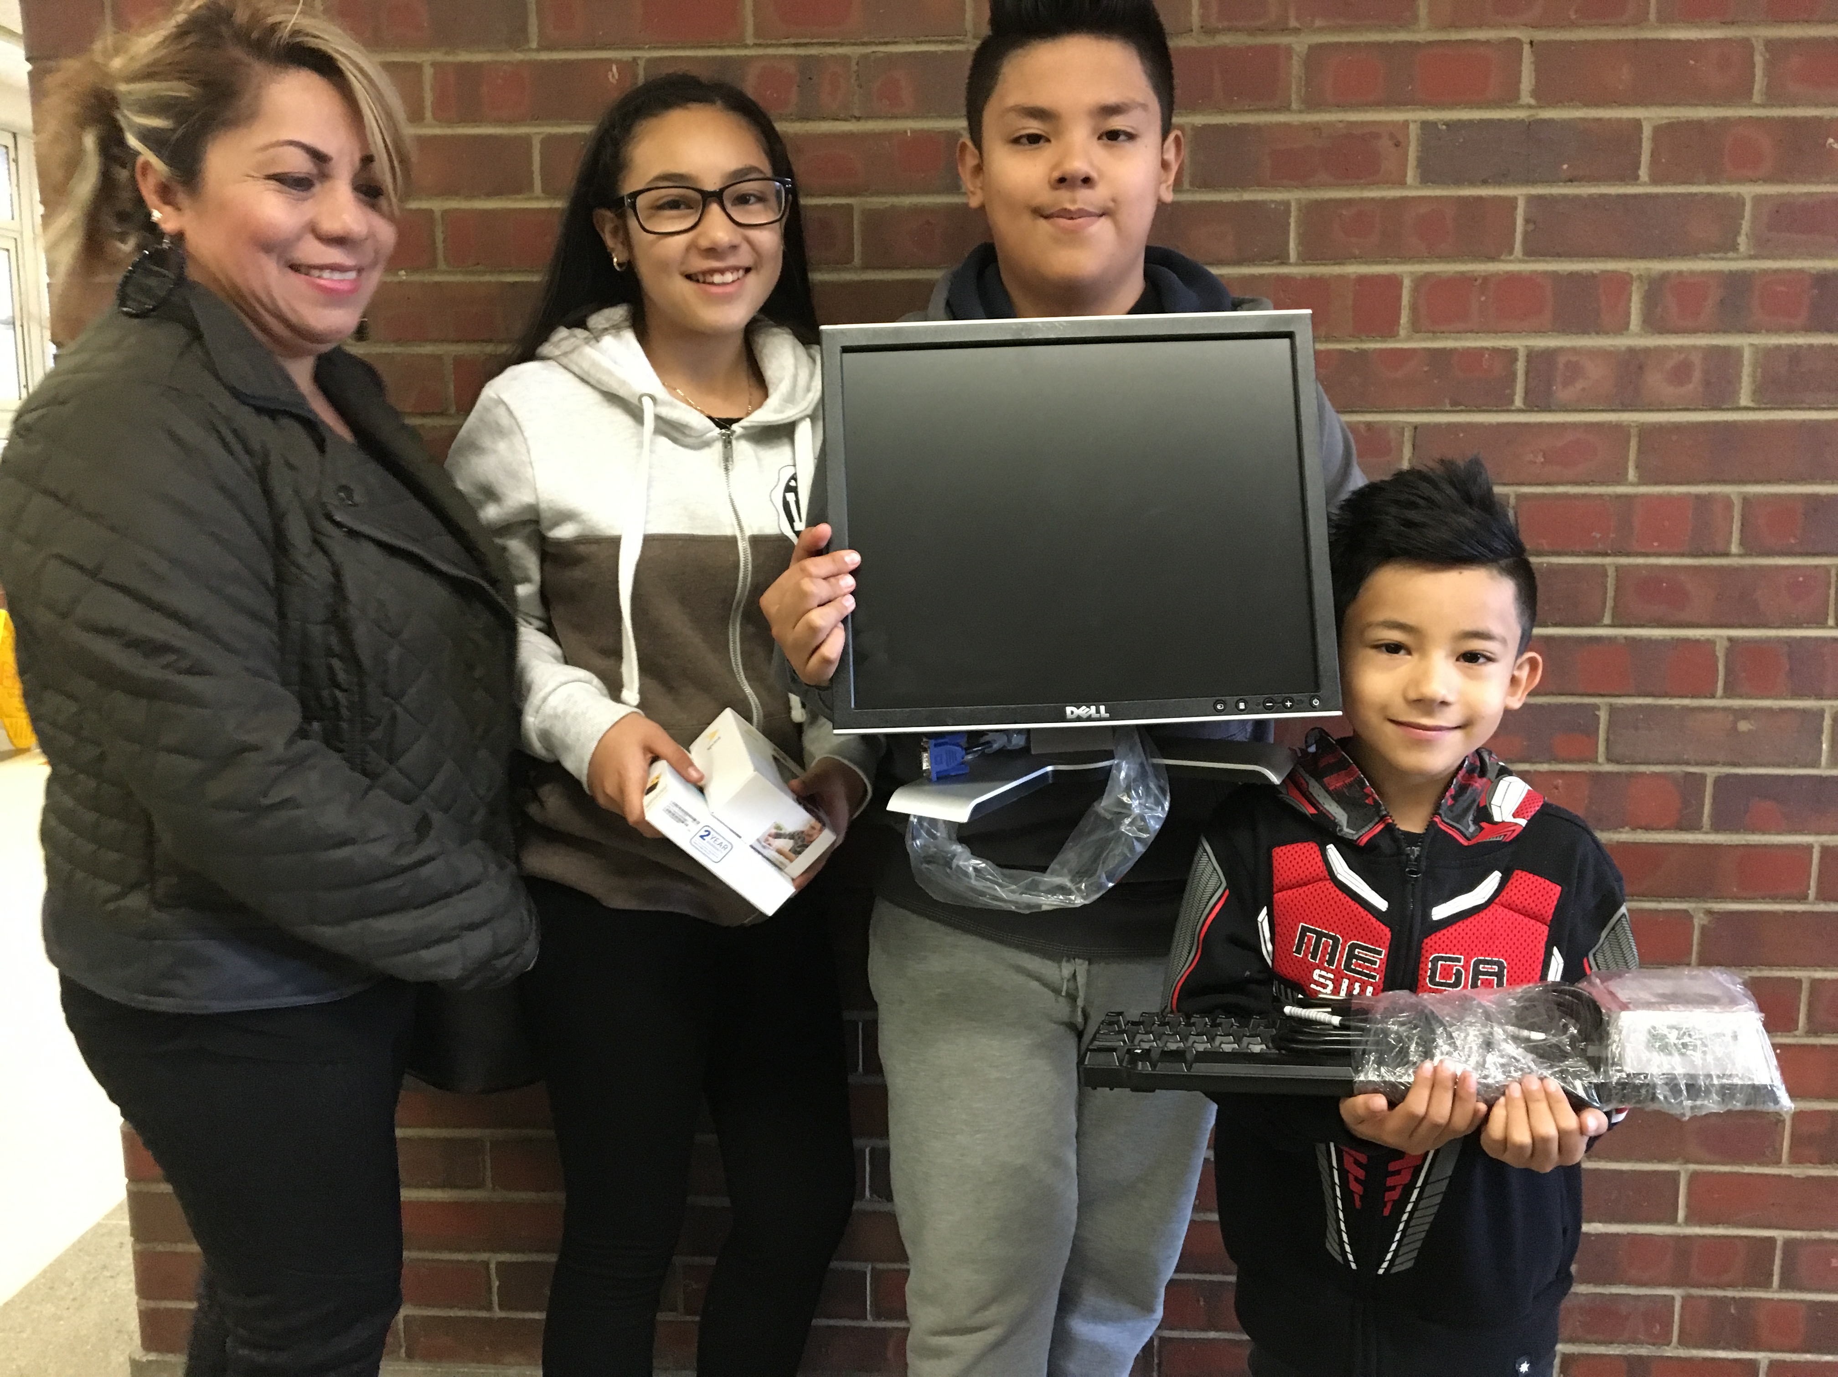
Satisfaction
  99% of all respondents who would recommend Mobile Beacon to a friend or family member.
Notes:
So if the program you are running depends on word of mouth – to grow and expand – you better be making people happy! – luckily The Bridging the Gap program does – and this puts them in a good position to make use of participant networks because of its high approval rating.

Slide 15
Leveraging the Strength of Community Networks
The Network Effect of Inclusion Programs
Notes:
So how do you even begin to use this word-of-mouth marketing? Or understand it? This next (and last) part of my presentation today is a glimpse into another forth-coming report due to be released later this month. where we looked at people’s personal communication networks to better understand how knowledge is transferred within a community.
To start, we need to understand some basics - There are a few different types of community network roles…..

Slide 16
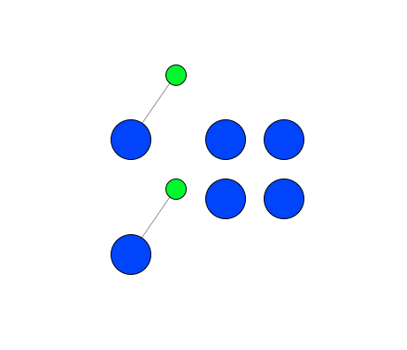
Network Roles: Isolates
An isolate can be a lone individual or a pair of people connected to each other, but not to the rest of the group.
Isolates make up 15% of the population
These tend to be older folks (over the age of 45)
Notes:
This group is not helpful in spreading word of a program or increasing adoption, instead, more resources will need to be expended on these types of individuals to bring them into the program. This said, finding a way to network them into a program or group may have the greatest impact on their life. (think a lonely senior who’s family is out of state)

Slide 17
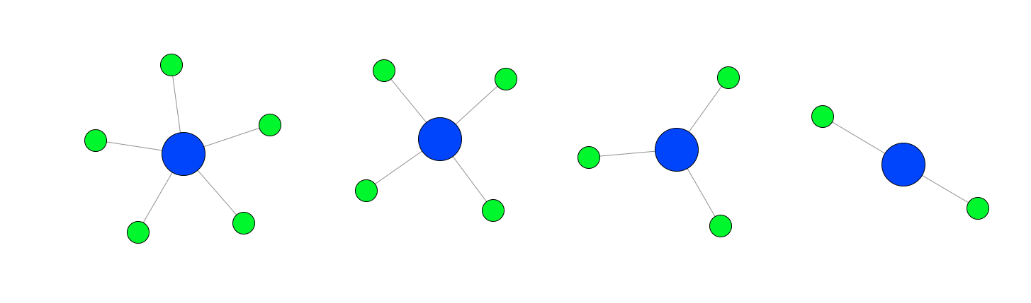
Network Roles: Stars
This is a person who may have many connections, but few if any of the connections are connected to each other.
Stars made up 25% of the population.
Notes:
These guys spread word about the program well, but may not hold the clout/influence on their connections to get them to act/adopt – they know a lot of people, but maybe not well - as their connections don’t often know each other.

Slide 18
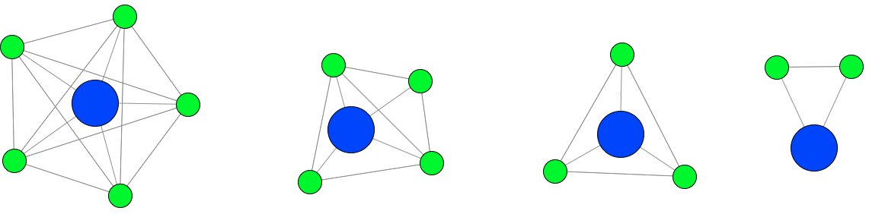
Network Roles: Cliques
The most connected persons in a group are cliques — most of their connections are also connected to each other.
Cliques make up 37% of the total population.
Another 23% are mix-mode (part Clique, part star)
Notes:
Getting one member of a clique to adopt makes it very likely others connected to them will too – these are the most influential members of a community. This is like a close knit group of friends. When one does something and finds value in it – that friend will tell the other group members – and because these are trusted contacts, and each person in the network knows one another, adoption of new ideas and technology (in this case) is easy and fast.

Slide 19
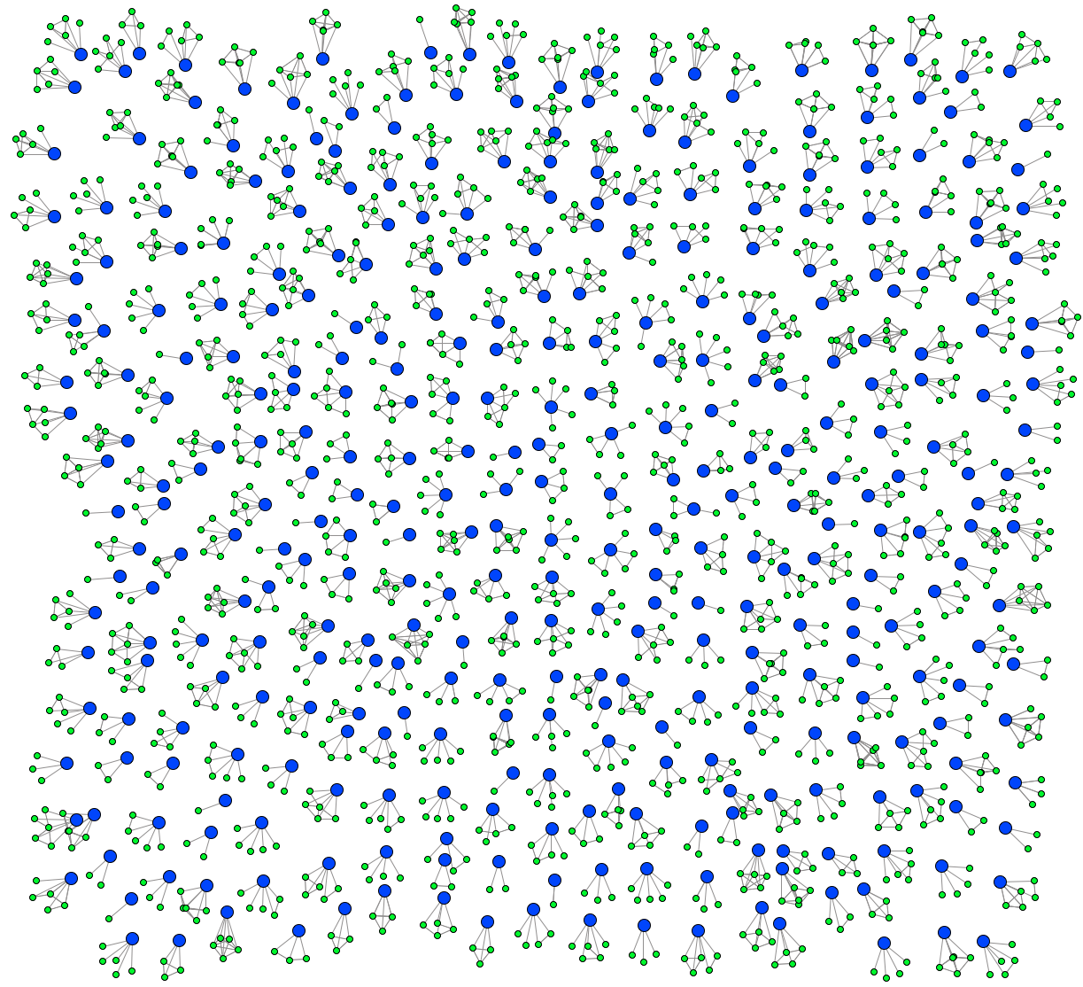
Network: Bridging the Gap
85% of the survey participants have a star, clique, or mix-mode network.
Notes:
So here is the whole picture….

Slide 20
Network Weaving for Inclusion and Program Growth
While income is often a driving force in program qualification, it does not a determine a person’s social role in the community
Spending time, money and focus on recruiting individuals within an income bracket across the board is not the most efficient approach if the goal is program growth and community penetration.
Instead, adding questions that identify a person’s role in the network at the point of intake, can offer alternative strategies for expending resources on weaving those most difficult to connect into existing cliques while incentivizing the better-connected participants to bring their existing networks into the fold.
Notes:
Rethink the intake process, learn more about a program’s participant’s personal network of support so you can identify which type of community role a new enrollee might be. Incentivize those that spread the word well of are positioned to influence others (which allows a program to conserve scarce resources and instead expend them on those more isolated and hard to reach).

Slide 21
Types of Useful Intake Questions
Is there a person, or are there people you go to for help with your computer or internet?
  Are YOU this person for others in your network?
Do you know others that struggle with the affordability or operability of their internet connection?
Are you already a member of any online communities?
  Facebook, twitter, Instagram, community groups
Notes:
How can a program incentivize participants to refer others to the program?

Slide 22
Thank you!
Samantha Schartman
Research Director, Connect Your Community institute
cyc.samantha@gmail.com
Twitter: @CYCSamantha

