Slide 1
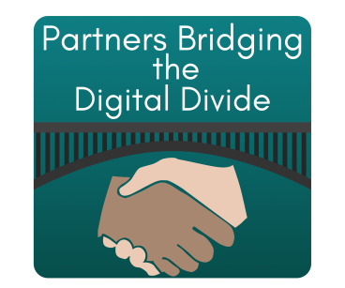
Partners Bridging the Digital Divide (pbdd.org)
Barry Glicklich, President
May 16, 2017
Notes:
1

Slide 2
What we do
Help nonprofits that promote digital inclusion learn from each other.
Host links to training material from many sources at http://pbdd.org/training/
Libraries, GCF LearnFree, TechBoomers, Connected Nation’s Drive Your Learning, NDIA Mailing List Recommendations
Creative commons material hosted on our site:
People’s Resource Center Course Material -
8 multi-week instructor-led course material with quizzes and material ranging from Introduction to Computers, Window Fundamentals, Excel, Word, Powerpoint – includes Best Practices guidelines
30+ Stand-alone tech talks on a variety of topics such as Creating Flyers in Word, Making a blog, Google Voice, 3D printing
RAILS Training Material from Reaching Across the Illinois Library System: Android tablet, cloud computing, Excel, Photoshop, Windows
pbdd.org
2
Notes:
2

Slide 3
Tips for Getting Started
Identify Needs - Who is being trained, skill level on entry and exit, style of training best suited, logistics
Reusing existing resources - assessments, training material, volunteer/staff expertise
Framework – instruction material, instructor training, additional resource availability
pbdd.org
3
Notes:
3

Slide 4
Keeping it Fresh
Feedback Culture - from students, from instructors, incorporating changes to technology
Mechanisms for comments, update, & roll-out - cloud-based sharing, change log with distribution
Work with Others - Local, Regional, National, Electronic
pbdd.org
4
Notes:
4

Slide 5
Use us!
Give us useful links, material to host
Use and share our information
Barry Glicklich – President, pbdd.org@gmail.com
pbdd.org
5
Notes:
5

